Slide 1
Virtual Memory (2)
Dr. Clinton Jeffery
CSE325 Principles of
Operating Systems
10/31/2022

Slide 2
Performance of
Demand Paging

Slide 3
Demand Paging Example
Memory access time = 200ns
Average page fault service time = 8ms
EAT = (1-p)*200 + p*8,000,000 = 200 + p*7,999,800
If one access out of 1000 causes a page fault, then EAT = 8.2us
  A slowdown by a factor of 40

Slide 4
Copy-on-Write
Copy-on-Write (COW) allows both parent and child processes to initially share the same pages in memory
  If either process modifies a shared page, only then is the page copied
COW allows more efficient process creation as only modified pages are copied
vfork() variation on fork() system call has parent suspend and child using copy-on-write address space of parent
  Superb when child calls exec()
  Very efficient

Slide 5
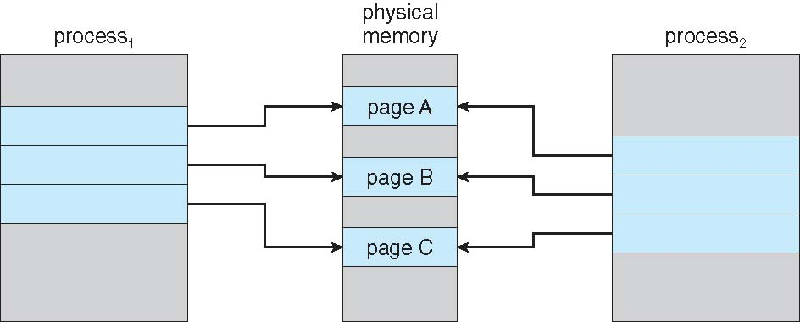
Before Process 1 Modifies Page C

Slide 6
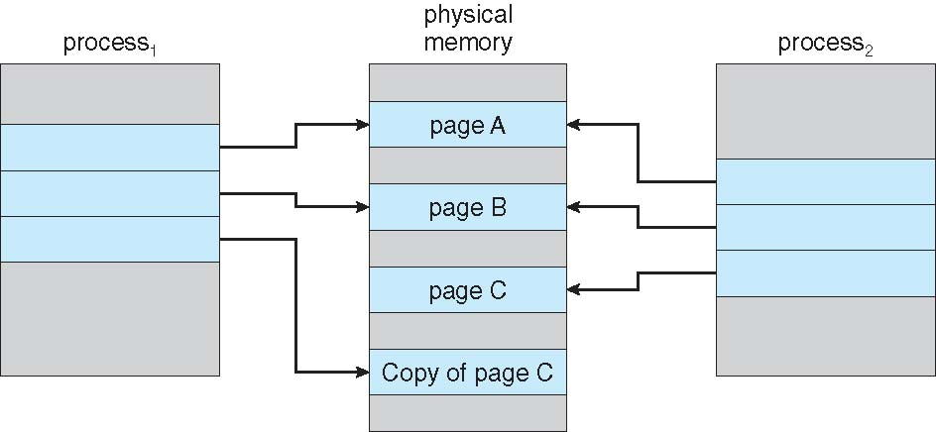
After Process 1 Modifies Page C

Slide 7
What Happens if There is no Free Frame?
Used up by process pages
Also in demand from the kernel, I/O buffers, etc
How much to allocate to each?
Page replacement – find some page in memory, but not really in use, page it out
  Performance – want an algorithm which will result in minimum number of page faults

Slide 8
Page Replacement
Prevent over-allocation of memory by modifying page-fault service routine to include page replacement
Use modify (dirty) bit to reduce overhead of page transfers – only modified pages are written to disk
Page replacement completes separation between logical memory and physical memory – large virtual memory can be provided on a smaller physical memory

Slide 9
Basic Page Replacement
Find the location of the desired page on disk
Find a free frame:
- If there is a free frame, use it
- If there is no free frame, use a page replacement algorithm to select a victim frame
- Write victim frame to disk if dirty
Bring the desired page into the (newly) free frame; update the page and frame tables
Continue the process by restarting the instruction that caused the trap

Slide 10
Page Replacement Algorithms
Want lowest page-fault rate on both first access and re-access
Evaluate algorithm by running it on a particular string of memory references (reference string) and computing the number of page faults on that string
  String is just page numbers, not full addresses
  Repeated access to the same page does not cause a page fault
  Results depend on number of frames available
In the examples if not specified, the reference string of referenced page numbers is
7,0,1,2,0,3,0,4,2,3,0,3,0,3,2,1,2,0,1,7,0,1

Slide 11
Random Replacement
Replaced page is chosen from m loaded frames with probability 1/m
Easy to implement but does not perform well

Slide 12
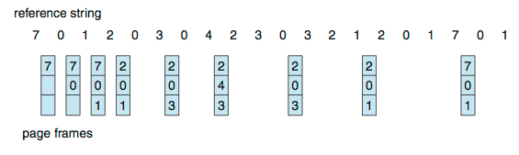
Optimal Algorithm
Replace page that will not be used for longest period of time
How do you know this?
  Can’t read the future
Used for measuring how well your algorithm performs
Notes:
9 is optimal for the example
Pros: Optimal solution and can be used as an off-line analysis method
Cons: No on-line implementation

Slide 13
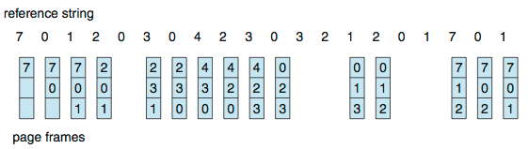
First-In-First-Out (FIFO) Algorithm
Reference string: 7,0,1,2,0,3,0,4,2,3,0,3,0,3,2,1,2,0,1,7,0,1
3 frames (3 pages can be in memory at a time per process)
15 page faults
What if we have 4 frames?
Consider reference string: 1 2 3 4 1 2 5 1 2 3 4 5
Notes:
Pros: Low-overhead implementation
Cons: May replace the heavily used pages
To see why, look at the pages in memory at each time unit. At time 6, the set of pages in the 3- frame memory is not a subset of the set in the 4-frame memory. This means the 4-frame memory will producing a page fault that does not occur in the 3-frame memory. You can see this again at time 7 and time 10.
How to track ages of pages?
Just use a FIFO queueTo

Slide 14
    Belady’s Anomaly
Adding more frames can cause more page faults!
Notes:
16 Page faults
An anomaly in space-time characteristics of certain programs running in a paging machine, Communications of ACM, 1969, Belady et. al.

