Slide 1
Virtual Memory (5)
Dr. Clinton Jeffery
CSE325 Principles of Operating Systems
11/11/2022

Slide 2
Thrashing
If a process does not have “enough” pages, the page-fault rate is very high
Page fault to get page
Replace existing frame
But quickly need replaced frame back
This leads to:
Low CPU utilization
Operating system thinking that it needs to increase the degree of multiprogramming
Another process added to the system
Thrashing ≡ a process is busy swapping pages in and out

Slide 3
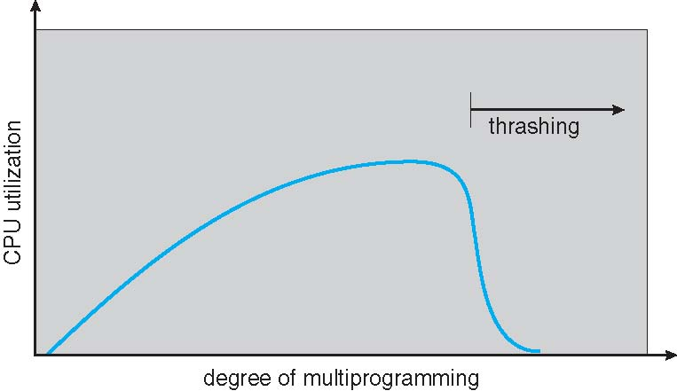
Thrashing (Cont.)

Slide 4
Demand Paging and Thrashing
Why does demand paging work? Locality model
Process migrates from one locality to another
Localities may overlap
Why does thrashing occur? Σ size of locality > total memory size
Limit effects by using local or priority page replacement
Notes:
The locality model states that, as a process executes, it moves from locality to locality. A locality is a set of pages that are actively used together.
A program is generally composed of several different localities, which may overlap.

Slide 5
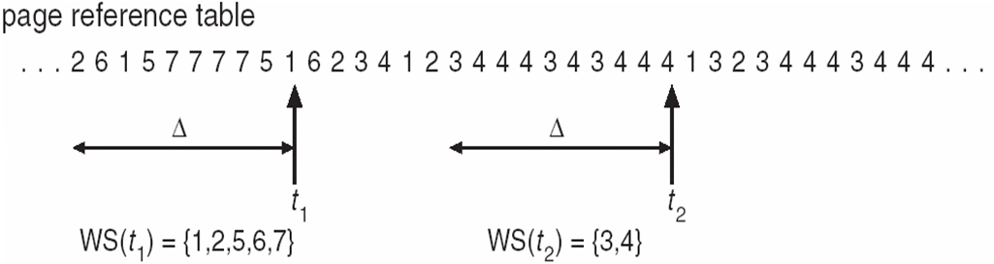
Working Set
Main idea
Define a working set as the set of pages in the most recent K page references to approximate the program’s locality
Keep the working set in memory will reduce page faults significantly
Approximate working set
The set of pages of a process used in the last T seconds
Notes:
The working set isn't a page replacement algorithm, but page-replacement algorithms can be designed to only remove pages that aren't in the working set for a particular process.

Slide 6
WSClock
Follow the clock hand
If the reference bit is 1
Set reference bit to 0
Set the current time for the page
Advance the clock hand
If the reference bit is 0, check “time of last use”
If the page has been used within δ, go to the next
If the page has not been used within δ and modify bit is 1
Schedule the page for page out and go to the next
If the page has not been used within δ and modify bit is 0
Replace this page
"WSCLOCK—a simple and effective algorithm for virtual memory management" by Richard W. Carr and John L. Hennessy, SOSP’81.

Slide 7
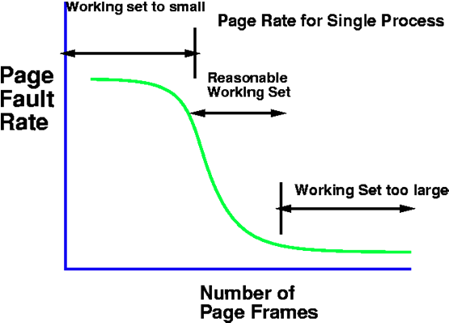
Working Set Size vs. Page Fault Rate

Slide 8
Page-Fault Frequency
More direct approach than working-set
Establish “acceptable” page-fault frequency (PFF) rate and use local replacement policy
If actual rate too low, process loses frame
If actual rate too high, process gains frame

Slide 9
Example: Windows
Uses demand paging with clustering. Clustering brings in pages surrounding the faulting page
Processes are assigned working set minimum and working set maximum
Working set minimum is the minimum number of pages the process is guaranteed to have in memory
A process may be assigned as many pages up to its working set maximum
When the amount of free memory in the system falls below a threshold, automatic working set trimming is performed to restore the amount of free memory
Working set trimming removes pages from processes that have pages in excess of their working set minimum

Slide 10
Allocating Kernel Memory
Treated differently from user memory
Often allocated from a free-memory pool
Kernel requests memory for structures of varying sizes
Some kernel memory needs to be contiguous
i.e. for device I/O
Notes:
Some of them are less than a page in size
certain hardware devices interact directly with physical memory-without the benefit of a virtual memory
interface-and consequently may require memory residing in physically contiguous pages.

Slide 11
Buddy Allocation (1)
Allocates memory from fixed-size segment consisting of physically-contiguous pages
Memory allocated using power-of-2 allocator
Satisfies requests in units sized as power of 2
Request rounded up to next highest power of 2
When smaller allocation needed than is available, current chunk split into two buddies of next-lower power of 2
Continue until appropriate sized chunk available
Kenneth C. Knowlton. A Fast storage allocator. Communications of the ACM 8(10):623-625, Oct 1965

Slide 12
Buddy Allocation (2)
For example, assume 256KB chunk available, kernel requests 21KB
Advantage – quickly coalesce unused chunks into larger chunk
Disadvantage - fragmentation
Notes:
The segment is initially divided into two buddies-which we will call AL and AR -each 128 KB in size. One of these buddies is further divided into two 64-KB buddies BL and BR- However, the next-highest power of 2 from 21 KB is 32 KB so either BL or BR is again divided into two 32-KB buddies, CL and CR. One of these buddies is used to satisfy the 21-KB request.
When the kernel releases the CL unit it was allocated, the system can coalesce C L and C R into a 64-KB segment. This segment, B L, can in turn be coalesced with its buddy B R to form a 128-KB segment. Ultimately, we can end up with the original256-KB segment.

Slide 13
In-class Work 7
Consider a system with 1MB of available memory and requests for 42KB, 396KB, 10KB, and 28KB. Show the amount of memory allocated for each request and the state of memory after each request.
How much internal fragmentation exists in this scenario?
How much external fragmentation exists in this scenario?

Slide 14
Answer
Original: 1MB
42KB -> 64KB: 64KB(x) 64KB 128KB 256KB 512KB
396KB->512KB: 64KB(x) 64KB 128KB 256KB 512KB(x)
10KB->16KB: 64KB(x) 16KB(x) 16KB 32KB 128KB 256KB 512KB(x)
28KB->32KB: 64KB(x) 16KB(x) 16KB 32KB(x) 128KB 256KB 512KB(x)
Internal fragmentation: (64-42)+(512-396)+(16-10)+(32-28) = 148KB
External fragmentation: 16+128+256 = 400KB

Slide 15
Slab Allocation (1)
Motivation
Frequent (de)allocation of cetain kernel objects
e.g. file struct and inode
Other allocators: overly general; assume variable size
Slab: cache of slots
slot size = object size
free memory management = bitmap
allocate: set bit and return slot
Free: clear bit
Used in FreeBSD and linux, implemented on top of buddy page allocator, for objects smaller than a page
Notes:
Object pool
When a program sets up a cache, it allocates a number of objects to the slabs associated with that cache. This number depends on the size of the associated slabs.

Slide 16
Slab Allocation (2)

