Slide 1
File Systems (2)
Dr. Clinton Jeffery
CSE325 Principles of
Operating Systems
11/16/2022

Slide 2
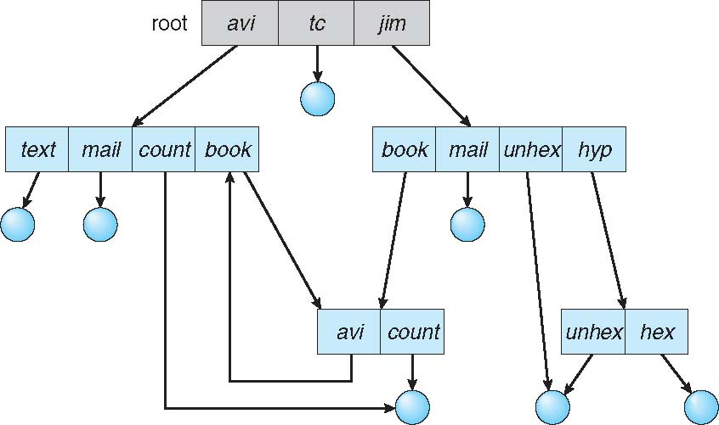
General Graph Directory
Cycles?
Notes:
If we start with a two-level directory and allow users to create subdirectories, a tree-structured directory results.
However, when we add links, the tree structure is destroyed, resulting in a simple graph structure

Slide 3
General Graph Directory
How do we guarantee no cycles?
  Allow only links to file not subdirectories
  Every time a new link is added use a cycle detection algorithm to determine whether it is OK

Slide 4
File-System Structure
File system resides on secondary storage (disks)
  Provided user interface to storage, mapping logical to physical
  Provides efficient and convenient access to disk by allowing data to be stored, located retrieved easily
Disk provides in-place rewrite and random access
  I/O transfers performed in blocks of sectors (32B – 4KB, HDD: usually 512B, SSD: 4K might be common)
File control block – storage structure consisting of information about a file
Device driver controls the physical device
File system organized into layers

Slide 5
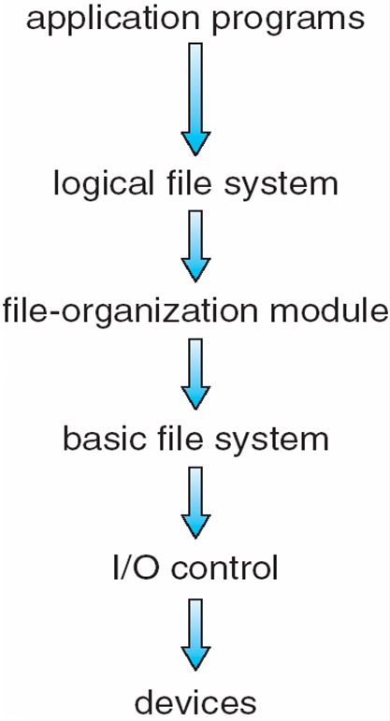
Layered File System
Notes:
The I/O control level consists of device drivers and interrupt handlers to transfer information between the main memory and the disk system. A device driver can be thought of as a translator.
The basic file system needs only to issue generic commands to the appropriate device driver to read and write physical blocks on the disk.
The file-organization module knows about files and their logical blocks, as well as physical blocks. By knowing the type of file allocation used and the location of the file, the file-organization module can translate logical block addresses to physical block addresses for the basic file system to transfer.
The logical file system manages metadata information. Metadata includes all of the file-system structure except the actual data (or contents of the files). The logical file system manages the directory structure to provide the file-organization module with the information the latter needs, given a symbolic file name. It maintains file structure via file-control blocks.

Slide 6
File-System Implementation (1)
We have system calls at the API level, but how do we implement their functions?
  On-disk and in-memory structures
Boot control block contains info needed by system to boot OS from that volume
  Needed if volume contains OS, usually first block of volume
Volume control block (UFS: superblock, NTFS: master file table) contains volume details
  Total # of blocks, # of free blocks, block size, free block pointers or array
Directory structure organizes the files
  UFS: Names and inode numbers, NTFS: master file table
Notes:
UFS: unix file systems, NTFS: new technology file systems (proprietary by microsoft)

Slide 7
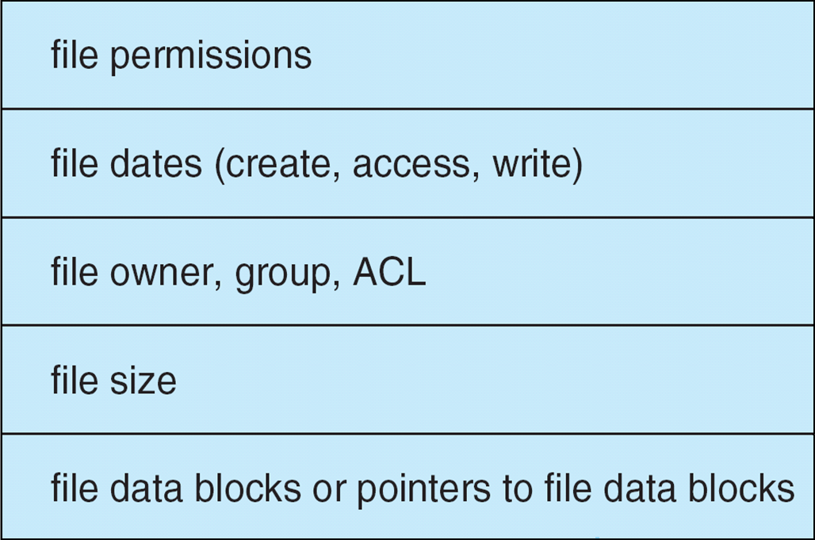
File-System Implementation (2)
Per-file File Control Block (FCB) contains many details about the file
  UFS: inode number, permissions, size, dates
  NTFS: stores into in master file table using relational DB structures
Notes:
NTFS: Windows NT file system

Slide 8
In-Memory File System Structures
An in-memory mount table contains information about each mounted volume.
An in-memory directory-structure cache holds the directory information of recently accessed directories. (For directories at which volumes are mounted, it can contain a pointer to the volume table.)
The system-wide open-file table contains a copy of the FCB of each open file, as well as other information.
The per-process open-file table contains a pointer to the appropriate entry in the system-wide open-file table, as well as other information.
Buffers hold file-system blocks when they are being read from disk or written to disk.

Slide 9
Directory Implementation
Linear list of file names with pointer to the data blocks
  Simple to program
  Time-consuming to execute
    Linear search time
    Could keep ordered alphabetically via linked list or use B+ tree
Hash Table – linear list with hash data structure
  Decreases directory search time
  Collisions – situations where two file names hash to the same location
  Only good if the number of entries is fixed, or use chained-overflow method
Notes:
Balanced tree
hash function needs the fixed number of entries, if it changes, the hash function has to change

Slide 10
Allocation Methods
An allocation method refers to how disk blocks are allocated for files:
Three methods
  Contiguous allocation
  Linked allocation
  Indexed allocation

Slide 11
Contiguous Allocation
Each file occupies set of contiguous blocks
Best performance in “most cases”
  Matters more for rotational magnetic media
Pros:
  Simple – only starting location (block #) and length (number of blocks) are required
  Direct access

Slide 12
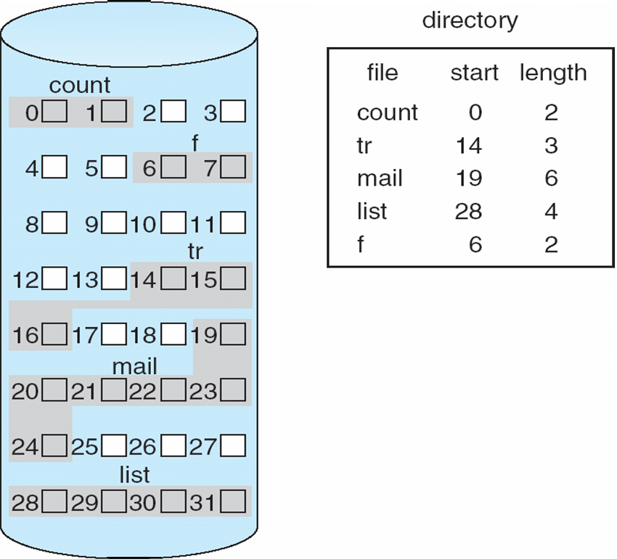
Contiguous Allocation
Mapping from logical address to physical address
  Block to be accessed = Q + starting address
  Displacement into block = R
Cons
Waste of space
Difficult to support dynamic file sizes (files cannot grow)
Notes:
First fit and best fit are the most common strategies used to select a free hole from the set of available holes. Simulations have shown that both first fit and best fit
are more efficient than worst fit in terms of both time and storage utilization. Neither first fit nor best fit is clearly best in terms of storage utilization, but first fit is generally faster.
External fragmentation

