Slide 1
File Systems (3)
Dr. Clinton Jeffery
CSE325 Principles of Operating Systems
11/16/2022

Slide 2
Extent-Based Systems
Many file systems (i.e., Veritas File System) use a modified contiguous allocation scheme
Extent-based file systems allocate disk blocks in extents
An extent is a contiguous area on a disk (a range of blocks)
Extents are allocated for file allocation
A file consists of one or more extents
Notes:
Veritas is a high-performance replacement of UFS

Slide 3
Linked Allocation
Each file is a linked list of disk blocks
Blocks may be scattered anywhere on the disk
Each block contains pointer to next block
block =
pointer

Slide 4
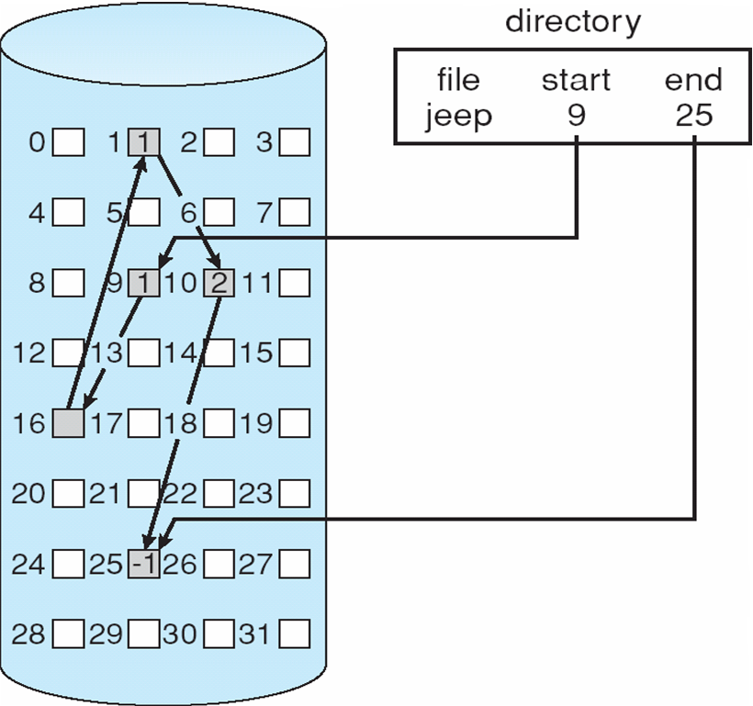
Linked Allocation
Pros
Simple – need only starting address
No external fragmentation
Cons
No random access
Seeks can be slow
Space required for pointers
(un)Reliability
Notes:
Small overhead
Reliability. Recall that the files are linked together by pointers scattered all over the disk, and consider what would happen if a pointer were lost or damaged.

Slide 5
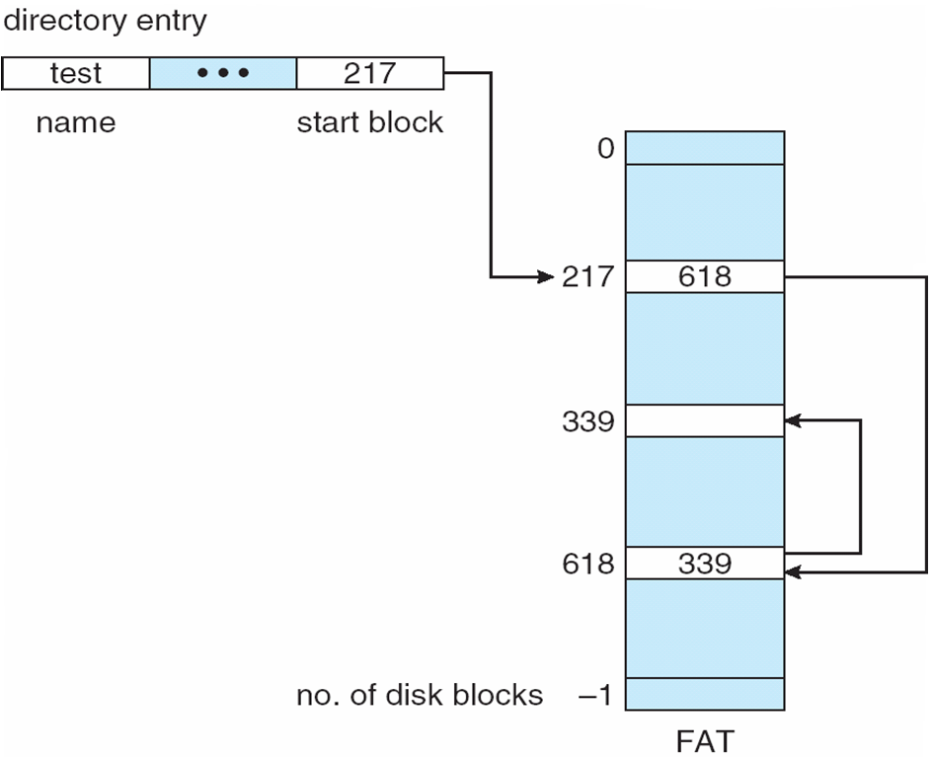
File-Allocation Table (FAT)
MS-DOS
Notes:
MS-DOS
The table entry indexed by that block number contains the block number of the next block in the file.
This chain continues until it reaches the last block, which has a special end-of-file value as the table entry.
An unused block is indicated by a table value of 0.
Allocating a new block to a file is a simple matter of finding the first 0-valued table entry and replacing the previous end-of-file value with the address of the new block. The 0 is then replaced with the end-of-file value.

Slide 6
Indexed Allocation
Each file has its own index block(s) of pointers to its data blocks
Logical view

Slide 7
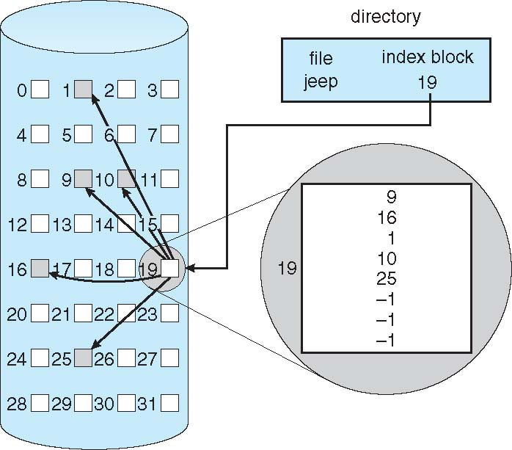
Example of Indexed Allocation
Pros
Simplify seeks
Random access
Dynamic access without external fragmentation
May link several index blocks together (for large files)
Cons
Overhead of index block
Notes:
When the file is created, all pointers in the index block are set to null. When the ith block is first written, a block is obtained from the free-space
manager, and its address is put in the ith index-block entry.

Slide 8
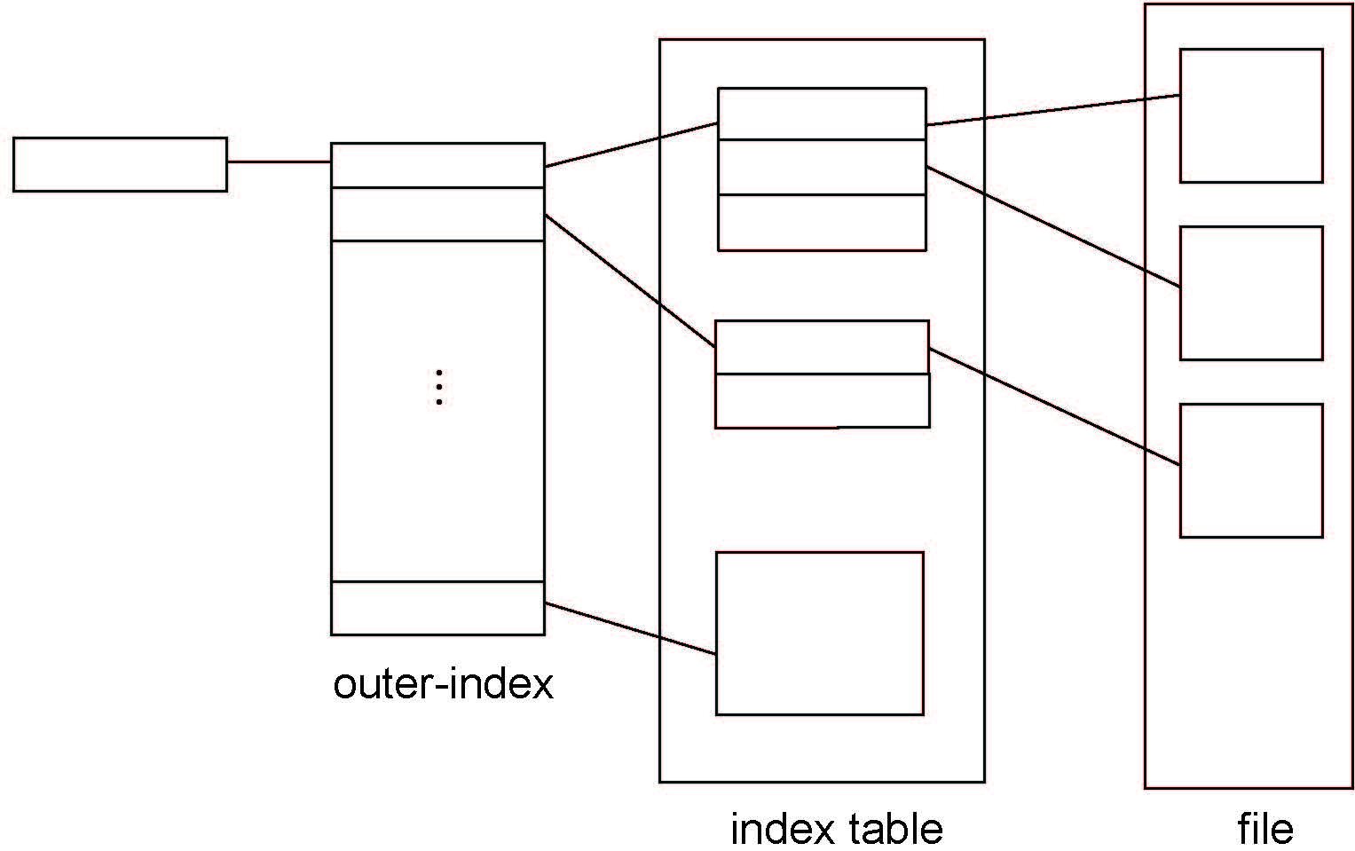
Indexed Allocation – Mapping

Slide 9
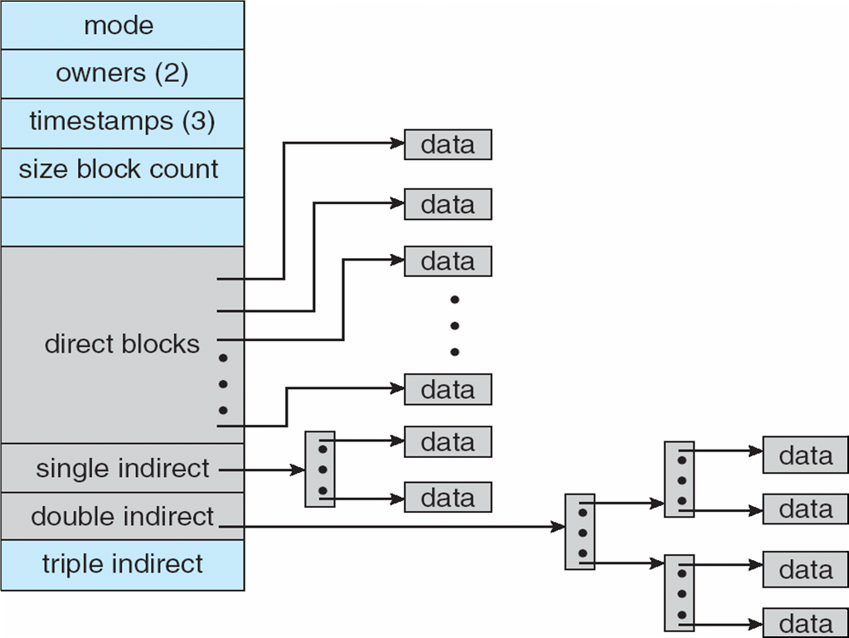
Combined Scheme: UNIX UFS
4K bytes per block, 32-bit addresses
Notes:
Keep the first, say, 15 pointers of the index block in the file’s inode. The first 12 of these pointers point to direct blocks; that is, they contain
addresses of blocks that contain data of the file.
The next three pointers point to indirect blocks. The first points to a single indirect block, which is an index block containing not data but the addresses of
blocks that do contain data. The second points to a double indirect block, which contains the address of a block that contains the addresses of blocks
that contain pointers to the actual data blocks. The last pointer contains the address of a triple indirect block.

Slide 10
Question
Consider a file system that uses inodes to represent files. Disk blocks are 8 KB in size, and a pointer to a disk block requires 4 bytes. This file system has 12 direct disk blocks, as well as single, double, and triple indirect disk blocks. What is the maximum size of a file that can be stored in this file system?
Notes:
8KB = 8192

Slide 11
Answer
12 direct disk blocks *8KB = 96KB
1 single disk block = 2048 * 8KB = 16384KB
1 double disk block = 2048^2 * 8 KB = 33554432 KB
1 triple disk block = 2048^3 * 8 KB = 68719476736 KB
Total = 64.03 TB

Slide 12
In-Class Work 8
Consider a UNIX file system with 10 direct pointers, 1 indirect pointer, 1 double-indirect pointer, and 1 triple-indirect pointer in the i-node. Assume that disk blocks are 4K bytes and that each pointer to a disk block requires 4 bytes.
(1) What is the largest possible file that can be supported with this design? (show your work as expression, no need to calculate the numeric result)
(2) Assume that the operating system has already read your file into the main memory. How many disk reads are required to read the data block 800 into memory? Explain your answer.

Slide 13
Answer
10*4KB + 1024*4KB + 1024*1024*4KB + 1024*1024*1024*4KB
Data block number 800 falls in the set of blocks accessible from the single indirect block (block number 10-1033). One disk read is required to read the indirect block, one disk read is required to read the actual data, for a total of two disk reads.

Slide 14
Free-Space Management (1)
File system maintains free-space list to track available blocks/clusters
(Using term “block” for simplicity)
Bit vector or bit map (n blocks)
0
1
2
n-1
…
1 ⇒ block[i] free
0 ⇒ block[i] occupied
bit[i] =

Block number calculation (first free block)
(number of bits per word) *
(number of 0-value words) +
offset of first 1 bit
CPUs have instructions to return offset within word of first “1” bit

Slide 15
Free-Space Management (2)
Bit map requires extra space
Example:
block size = 4KB = 2¹² bytes
disk size = 2⁴⁰ bytes (1 terabyte)
n = 2⁴⁰/2¹² = 2²⁸ bits (or 256MB)
if clusters of 4 blocks -> 32MB of memory
Easy to get contiguous files
Notes:
A 1.3-GB disk with 512-byte blocks would need a bit map of over 332 KB to track its free blocks
A1-TB disk with 4-KB blocks requires 256 MB to store its bit map.

Slide 16
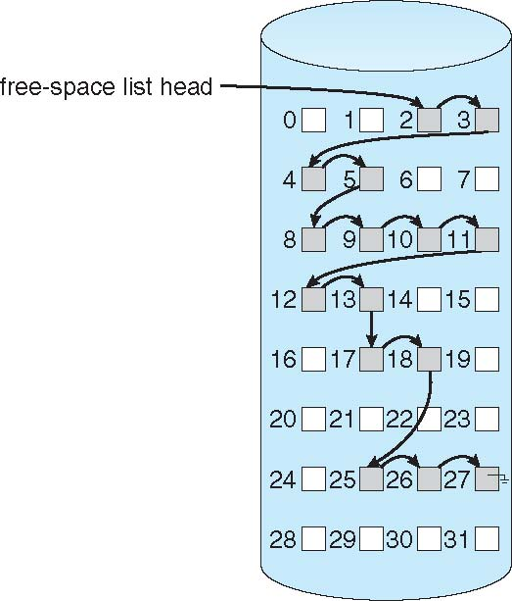
Linked Free Space List on Disk
Linked list (free list)
Cannot get contiguous space easily
No waste of space
No need to traverse the entire list (if # free blocks recorded)

Slide 17
Free-Space Management (3)
Grouping
Modify linked list to store address of next n-1 free blocks in first free block, plus a pointer to next block that contains free-block-pointers (like this one)
Find the addresses of a large number of free blocks quickly
Counting
Because space is frequently contiguously used and freed, with contiguous-allocation algorithm, extents, or clustering
Keep address of first free block and count of following free continguous blocks
Free space list then has entries containing addresses and counts
The entries can be stored in a balanced tree for efficient lookup, insertion, and deletion.
Notes:
Each entry in the free-space list then consists of a disk address and a count.

Slide 18
Layers of xv6 File System
Chapter 6 of xv6 book

Slide 19
xv6 File System Structure
fs.h, fs.c, mkfs.c
struct superblock {
uint size; // Size of file system image (blocks)
uint nblocks; // Number of data blocks
uint ninodes; // Number of inodes.
uint nlog; // Number of log blocks
uint logstart; // Block number of first log block
uint inodestart; // Block number of first inode block
uint bmapstart; // Block number of first free map block
};

Slide 20
On-disk inode structure
struct dinode {
short type; // File type
short major; // Major device number (T_DEV only)
short minor; // Minor device number (T_DEV only)
short nlink; // Number of links to inode in file system
uint size; // Size of file (bytes)
uint addrs[NDIRECT+1]; // Data block addresses
};
NDIRECT = 12
NINDIRECT = BSIZE/4 = 512/4 = 1288

