Slide 1
Storage Systems (2)
Dr. Clinton Jeffery
CSE325 Principles of Operating Systems
11/30/2022

Slide 2
Selecting a Disk-Scheduling Algorithm
SSTF is common and has a natural appeal
SCAN and C-SCAN perform better for systems that place a heavy load on the disk
Performance depends on the number and types of requests
Requests for disk service can be influenced by the file-allocation method
The disk-scheduling algorithm should be written as a separate module of the operating system, allowing it to be replaced with a different algorithm if necessary
Either SSTF or LOOK is a reasonable choice for the default algorithm
Notes:
For example, only one request, al algorithms are the same
Contiguous allocation vs. linked allocation

Slide 3
In-class Work 9
Suppose that a disk drive has 200 cylinders, numbered 0 to 199. The drive is currently serving a request at cylinder 100. The queue of pending requests, in FIFO order, is:
55, 58, 18, 90, 160, 38
Starting from the current head position, what is the total distance (in cylinders) that the disk arm moves to satisfy all the pending requests for each of the following disk-scheduling algorithms? For SCAN and LOOK, assume the head moves towards cylinder 199 first.
FCFS, SSTF, SCAN, LOOK, C-SCAN, C-LOOK
Notes:
FCFS: 45, 3, 40, 72, 70, 122 = 352
SSTF: 10, 32, 3, 17, 20, 142 = 224
SCAN: 60, 39, 109, 32, 3, 17, 20 = 280
LOOK: 60, 70, 32, 3, 17, 20 = 202
C-SCAN: 60, 39, 199, 18, 20, 17, 3, 32 = 99 + 199 + 90 = 388
C-LOOK: 60, 142, 20, 17, 3, 32 = 274

Slide 4
Answer
FCFS: 352
SSTF: 224
SCAN: 280
LOOK: 202
C-SCAN: 388
C-LOOK: 274

Slide 5
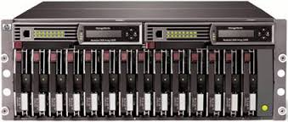
Disk Arrays
Have many disk drives and therefore many disk arms (rather than a single disk arm):
Increase potential throughput

Slide 6
Dependability
How to decide when a system is operating properly?
Infrastructure providers now offer Service Level Agreements (SLA) to guarantee that their networking or power service would be dependable
Systems alternate between 2 states of service with respect to an SLA:
Service accomplishment, where the service is delivered as specified in SLA
Service interruption, where the delivered service is different from the SLA
Failure = transition from state 1 to state 2
Restoration = transition from state 2 to state 1
Notes:
6

Slide 7
Availability
Module availability measures service as alternate between the 2 states of accomplishment and interruption (number between 0 and 1, e.g. 0.9)
Mean Time To Repair (MTTR) measures Service Interruption
Mean Time Between Failures (MTBF) = MTTF+MTTR
Module availability = MTTF / ( MTTF + MTTR)

Slide 8
Dependability of Disk Arrays
with many more devices, dependability decreases: N devices generally have 1/Nth of the reliability of a single device.
Reliability metric: MTTF
50,000 Hours ÷ 70 disks = 700 hours
Disk system MTTF: Drops from 6 years to 1 month!
Result: disk array have many more faults than a small number of large disks

Slide 9
RAID
Add redundant disks to tolerate faults:
Dependability increases
If a single disk fails: the lost information is reconstructed from the redundant information
RAID: redundant array of inexpensive disks
Spread the data over multiple disks: striping
If second disk fail while the first one is being repaired, cannot recover
Not a problem: MTTF of a disk is tens of years, while MTTR is hours -> redundancy makes the measured reliability of 100 disks much higher than that of a single disk
Different RAID levels: 0 - 6
Notes:
MTTR: mean time to repair

Slide 10
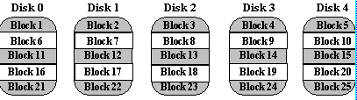
RAID 0 – No Redundancy
Data are striped but there is no redundancy to tolerate disk failure
Data is divided into blocks and is spread in a fixed order among all the disks in the array.
Improves the performance for large access because many disks operate in parallel
No space overhead, no fault tolerance

Slide 11
RAID 1: Disk Mirroring/Shadowing
The disk is fully duplicated onto its “mirror” (or more)
Very high availability can be achieved
Bandwidth sacrifice on write:
Logical write = two physical writes
Reads may be optimized
Most expensive solution: 100% capacity overhead
(RAID 2 no longer used, so skip)
11
Notes:
CS252 S05
11

Slide 12
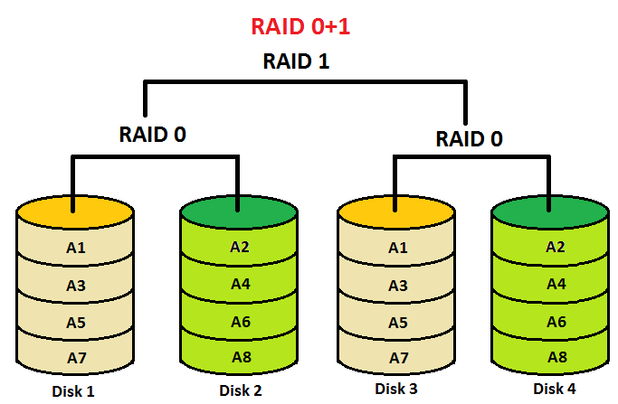
RAID 0+1

Slide 13
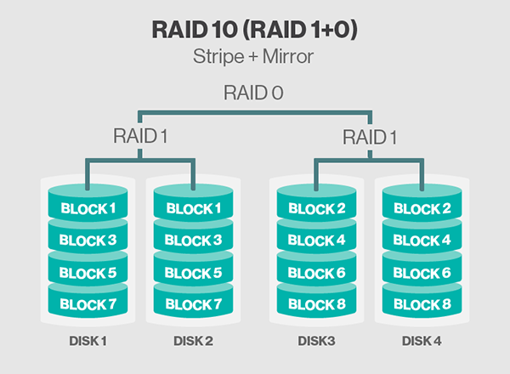
RAID 1+0

Slide 14
RAID 3 – Parity Disk (Bit-Interleaved)
10010011
11001101
10010011
. . .
P
logical record
1
0
1
0
0
0
1
1
1
1
0
0
1
1
0
1
1
0
1
0
0
0
1
1
1
1
0
0
1
1
0
1
Striped physical
records
P contains sum of
other disks per stripe mod 2 (“parity”)
If disk fails, subtract
P from sum of other disks to find missing information
Notes:
Even parity: even number of 1s

Slide 15
RAID 3 – Parity Disk
Sum computed across recovery group to protect against hard disk failures, stored in P disk
Logically, a single high capacity, high transfer rate disk: good for large transfers
Wider arrays reduce capacity costs
33% capacity cost for parity if 3 data disks and 1 parity disk

Slide 16
Inspiration for RAID 4 (Block-interleaved)
RAID 3 relies on parity disk to discover errors on Read
But every sector has an error detection field
To catch errors on read, rely on error detection field vs. the parity disk
Allows independent reads to different disks simultaneously
Notes:
CS252 S05
16

Slide 17
Inspiration for RAID 5
RAID 4 works well for small reads
Small writes (write to one disk):
Option 1: read other data disks, create new sum and write to Parity Disk
Option 2: since P has old sum, compare old data to new data, add the difference to P
Small writes are limited by Parity Disk: Write to D0, D5 both also write to P disk
D0
D1
D2
D3
P
D4
D5
D6
D7
P
Notes:
CS252 S05
17

Slide 18
Problems of Disk Arrays: Small Writes
RAID-5: Small Write Algorithm
1 Logical Write = 2 Physical Reads + 2 Physical Writes
D0'
D0
D1
D2
D3
P
new
data
old
data
old
parity
(1. Read)
(2. Read)
+
XOR
+
XOR
(3. Write)
(4. Write)
D0'
D1
D2
D3
P'
Notes:
CS252 S05
18

Slide 19
RAID 5 – High I/O Interleaved Parity
D0
D1
D2
D3
P
Increasing
Logical
Disk
Addresses
Independent writes
possible because of
interleaved parity
D4
D5
D6
P
D7
D8
D9
P
D10
D11
D12
P
D13
D14
D15
Example: write to D0, D5 uses disks 0, 1, 3, 4
P
D16
D17
D18
D19
D20
D21
D22
D23
P
.
.
.
.
.
.
.
.
.
.
.
.
.
.
.
Disk Columns

Slide 20
RAID 6: Recovering from 2 failures
Why > 1 failure recovery?
operator accidentally replaces the wrong disk during a failure
since disk bandwidth is growing more slowly than disk capacity, the MTT Repair a disk in a RAID system is increasing ⇒ increases the chances of a 2nd failure during repair since takes longer
reading much more data during reconstruction meant increasing the chance of an uncorrectable media failure, which would result in data loss
Notes:
CS252 S05
20

Slide 21
RAID 6: Recovering from 2 failures
Network Appliance’s row-diagonal parity or RAID-DP
Like the standard RAID schemes, it uses redundant space based on parity calculation per stripe
Since it is protecting against a double failure, it adds two check blocks per stripe of data.
If p+1 disks total, p-1 disks have data; assume p = 5
Row parity disk is just like in RAID 4
Even parity across the other 4 data blocks in its stripe
Each block of the diagonal parity disk contains the even parity of the blocks in the same diagonal
Notes:
CS252 S05
21

Slide 22
Example p = 5
Row diagonal parity starts by recovering one of the 4 blocks on the failed disk using diagonal parity
Since each diagonal misses one disk, and all diagonals miss a different disk, 2 diagonals are only missing 1 block
Once the data for those blocks is recovered, then the standard RAID recovery scheme can be used to recover two more blocks in the standard RAID 4 stripes
Process continues until two failed disks are restored
Data Disk 0 | Data Disk 1 | Data Disk 2 | Data Disk 3 | Row Parity | Diagonal Parity
0 | 1 | 2 | 3 | 4 | 0
1 | 2 | 3 | 4 | 0 | 1
2 | 3 | 4 | 0 | 1 | 2
3 | 4 | 0 | 1 | 2 | 3
Notes:
CS252 S05
22
Disks 1 and 3 fail
Use diagonal 0 and 2 to recover blocks 2(0) of 3 and 1(2) of disk 1, then row 1 and 2 to recover blocks 1(4) of 3 and 2(3) in disk 1
Then use diagonal 3 and 4 to recover blocks 0(3) of 3 and 3(4) in disk 1, row 0 and 3 to recover blocks 0(1) of 1 and 1(3) in disk 3

Slide 23
RAID Summary

Slide 24
Question
Consider a RAID level 5 organization comprising five disks, with the parity for sets of four blocks on four disks stored on the fifth disk. How the blocks are accessed in order to perform the following?
(1) A write of one block of data
(2) A write of seven continuous blocks of data, assume the blocks begin at a four-block boundary

Slide 25
Answer
A write of one block of data requires the following: read of the parity block, read of the old data stored in the target block, computation of the new parity based on the differences between the new and old contents of the target block, and write of the parity block and the target block.
Assume that the seven contiguous blocks begin at a four-block boundary. A write of seven contiguous blocks of data could be performed by writing the seven contiguous blocks, writing the parity block of the first four blocks, reading the eight block, computing the parity for the next set of four blocks and writing the corresponding parity block onto disk.

Slide 26
In-class Work 10
Consider a 4-drive, 200 GB-per-drive RAID array. What is the available data storage capacity for each of the RAID levels, 0, 1+0, 3, 4, 5, and 6?
Notes:
RAID 0: 800 GB
RAID 1+0: 400 GB
RAID 3: 600 GB
RAID 4: 600 GB
RAID 5: 600 GB
RAID 6: 400 GB

