Slide 1
Processes (2)
Dr. Clinton Jeffery
CSE325 Principles of Operating Systems
8/29/2022
Notes:
1

Slide 2
Schedulers
Short-term scheduler (or CPU scheduler) – selects which process should be executed next and allocates CPU
  Sometimes the only scheduler in a system
  Short-term scheduler is invoked frequently (milliseconds) ⇒ (must be fast)
Long-term scheduler (or job scheduler) – selects which processes should be brought into the ready queue
  Long-term scheduler is invoked infrequently (seconds, minutes) ⇒ (may be slow)
  The long-term scheduler controls the degree of multiprogramming
Processes can be described as either:
  I/O-bound process – spends more time doing I/O than computations, many short CPU bursts
  CPU-bound process – spends more time doing computations; few very long CPU bursts
Long-term scheduler strives for good process mix
Notes:
degree of multiprogramming: the number of processes in memory
long-term scheduler select a good process mix of I/O-bound and CPU-bound processes.
If all processes are I/O bound, the ready queue will almost always be empty, and the short-term scheduler will have little to do. If all processes are CPU bound, the I/O waiting queue will almost always be empty, devices will go unused, and again the system will be unbalanced. The system with the best performance will thus have a combination of CPU-bound and I/O-bound processes.

Slide 3
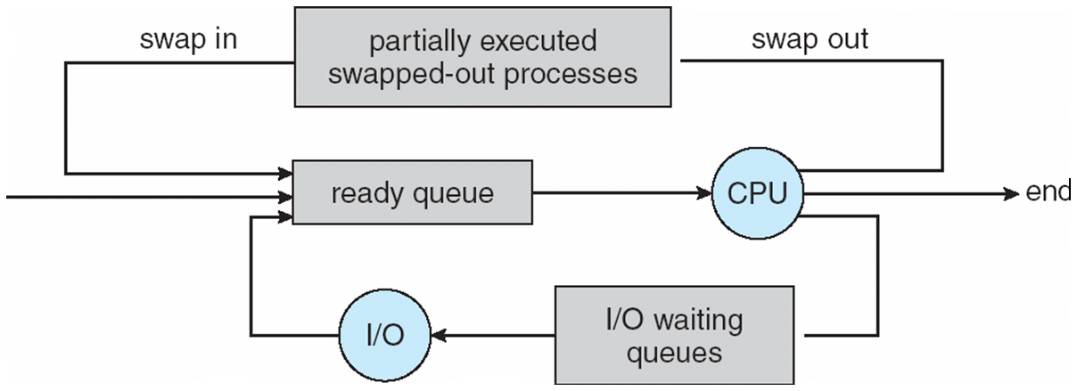
Addition of Medium Term Scheduling
Medium-term scheduler can be added if degree of multiple programming needs to decrease
  Remove process from memory, store on disk, bring back in from disk to continue execution: swapping
Notes:
Some operating systems, such as time-sharing systems, may introduce an additional, intermediate level of scheduling.
Reduce the degree of multiprogramrning

Slide 4
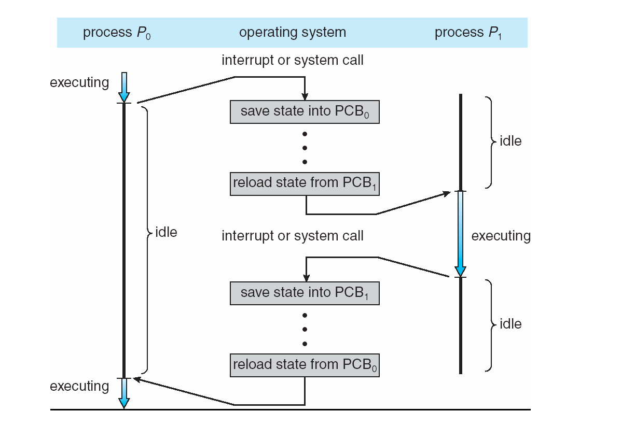
Context Switch
When CPU switches to another process, the system must save the state of the old process and load the saved state for the new process via a context switch
Context of a process represented in the PCB
Context-switch time is overhead; the system does no useful work while switching
  The more complex the OS and the PCB, the longer the context switch
Time dependent on hardware support
  Some hardware provides multiple sets of registers per CPU.
Notes:
Advanced memory-management techniques may require extra data to be switched with each context.

Slide 5
Operations on Processes
System must provide mechanisms for:
  process creation
  process termination

Slide 6
Process Creation
Parent process create children processes, which, in turn create other processes, forming a tree of processes
Generally, process identified and managed via a process identifier (pid)
Resource sharing options
  Parent and children share all resources
  Children share subset of parent’s resources
  Parent and child share no resources
Execution options
  Parent and children execute concurrently
  Parent waits until children terminate
Notes:
Unique pid: UNIX and Windows

Slide 7
A Tree of Processes in Linux

Slide 8
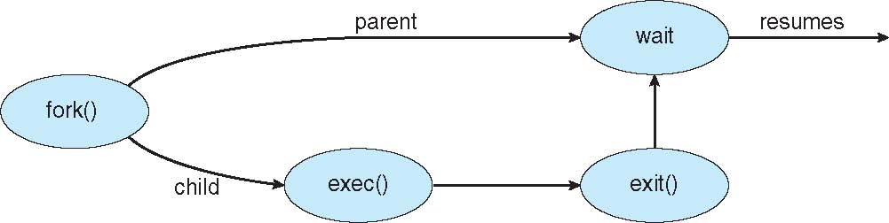
Process Creation (Cont.)
Address space
  Child duplicate of parent
  Child has a new program loaded into it
UNIX examples
  fork() system call creates new process
  exec() system call used after a fork() to replace the process’ memory space with a new program
Notes:
The only difference between the child and the parent is the value returned by fork
* In the parent process, fork returns the process id of the child
In the child process, the return value is 0
A new process is created by the fork() system call. The new process consists of a copy of the address space of the original process.
Typically, the exec() system call is used after a fork() system call by one of the two processes to replace the process's memory space with a new program. The exec() system call loads a binary file into memory (destroying
the memory image of the program containing the exec() system call) and starts its execution.

Slide 9
Process Creation: Example
When you log in to a machine running Unix, you create a shell process.
Every command you type into the shell is a child of your shell process and is an implicit fork and exec pair.
For example, you type emacs, the OS “forks” a new process and then “exec” (executes) emacs.
If you type an & after the command, Unix will run the process in parallel with your shell, otherwise, your next shell command must wait until the first one completes.

Slide 10
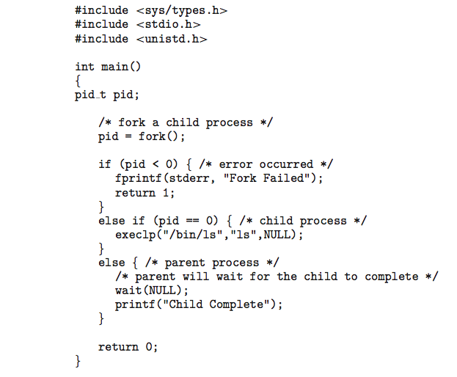
C Program Forking Separate Process
In the parent process, fork returns the process id of the child
In the child process, the return value is 0

Slide 11
Process Termination
Process executes last statement and then asks the operating system to delete it using the exit() system call.
  Returns status data from child to parent (via wait())
  Process’ resources are deallocated by operating system
Parent may terminate the execution of children processes using the abort() system call. Some reasons for doing so:
  Child has exceeded allocated resources
  Task assigned to child is no longer required
  The parent is exiting and the operating systems does not allow a child to continue if its parent terminates

