Slide 1
CPU Scheduling (3)
Dr. Clinton Jeffery
CSE325 Principles of
Operating Systems
9/7/2022

Slide 2
Length of Next CPU Burst
Estimate – the next CPU burst will often be similar to the previous one(s)
  Given several processes’ next-burst estimates, pick process with shortest predicted next CPU burst
Can be done by using the length of previous CPU bursts, using “exponential averaging”
Commonly, α set to ½
Preemptive version called shortest-remaining-time-first
Notes:
2

Slide 3
Examples of
Exponential Averaging
α =0
  τ_{n+1} = τ_{n}
  Recent history does not count
α =1
  τ_{n+1} = α t_{n}
  Only the actual last CPU burst counts
If we expand the formula, we get:
τ_{n+1} = α t_{n}+(1 - α)α t_{n} ₋₁ + …
+(1 - α )^{j} α t_{n} _{-j} + …
+(1 - α )^{n +1} τ₀
Since both α and (1 - α) are less than or
equal to 1, each successive term has less
weight than its predecessor
Notes:
3

Slide 4
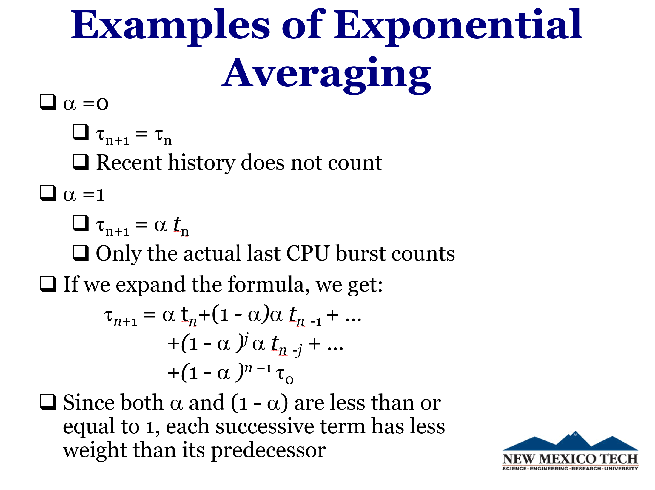

Slide 5
Shortest-remaining-time-first
Now we add the concepts of varying arrival times and preemption to the analysis
Process Arrival TimeT Burst Time
P₁ 0 8
P₂ 1 4
P₃ 2 9
P₄ 3 5
Preemptive SJF Gantt Chart
Average waiting time = [(10-1)+(1-1)+(17-2)+(5-3)]/4 = 26/4 = 6.5 msec
Notes:
5

Slide 6
Priority Scheduling
A priority number (integer) is associated with each process
The CPU is allocated to the process with the highest priority
  Preemptive
  Nonpreemptive
SJF is priority scheduling where priority is the inverse of predicted next CPU burst time
Problem ≡ Starvation – low priority processes may never execute
Solution ≡ Aging – as time progresses,
increase the priority of the process
Notes:
6
The SJF algorithm is a special case of the general priority scheduling algorithm.
Rumor has it that when they shut down the IBM 7094 at MIT in 1973, they found a low-priority process that had been submitted in 1967 and had not yet been run.

Slide 7
Example of Priority Scheduling
ProcessA arri Burst TimeT Priority
P₁ 10 3
P₂ 1 1
P₃ 2 4
P₄ 1 5
P₅ 5 2
Priority scheduling Gantt Chart
Average waiting time = 8.2 msec
2
5
Notes:
7

Slide 8
Round Robin (RR)
Each process gets a small unit of CPU time (time quantum q), usually 10-100 milliseconds. After this time has elapsed, the process is preempted and added to the end of the ready queue.
If there are n processes in the ready queue and the time quantum is q, then each process gets 1/n of the CPU time in chunks of at most q time units at once. No process waits more than (n-1)q time units.
Timer interrupts every quantum to schedule next process
Performance
  q large ⇒ FIFO
  q small ⇒ q
Notes:
8
xv6 uses round robin

