Slide 1
CPU Scheduling (4)
Dr. Clinton Jeffery
CSE325 Principles of Operating Systems
9/9/2022

Slide 2
Round Robin (RR)
In order to not starve any process, each process gets a small unit of CPU time (time quantum q), usually 10-100 milliseconds. After this time has elapsed, the process is preempted and added to the end of the ready queue.
If there are n processes in the ready queue and the time quantum is q, then each process gets 1/n of the CPU time in chunks of at most q time units at once. No process waits more than (n-1)q time units.
Timer interrupts every quantum to schedule next process
Performance
q large ⇒ FIFO
q small ⇒ q
Notes:
2
xv6 uses round robin

Slide 3
Example of RR with Time Quantum = 4
Process Burst Time
P₁ 24
P₂ 3
P₃ 3
The Gantt chart is:
Typically, higher average turnaround than SJF, but better response
q should be large compared to context switch time
q usually 10ms to 100ms, context switch < 10 usec
Notes:
3

Slide 4
Average Waiting Time
P1: (0-0) + (10 - 4) = 6
P2: (4-0) = 4
P3: (7 - 0) = 7
Avg. waiting time: (6 + 4 + 7)/3 = 17/3 ms

Slide 5
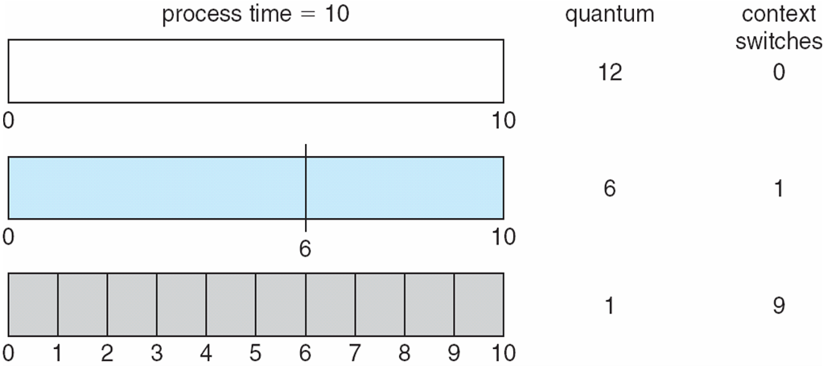
Time Quantum and Context Switch Time

Slide 6
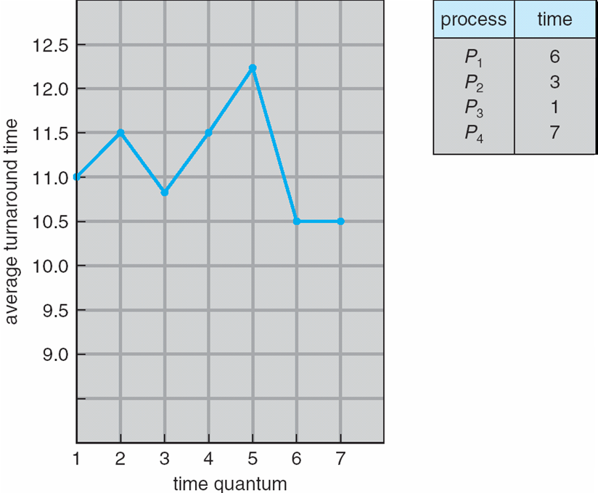
Turnaround Time Varies With The Time Quantum
80% of CPU bursts should be shorter than q
Notes:
Although the time quantum should be large compared with the context switch time, it should not be too large. If the time quantum is too large, RR
scheduling degenerates to an FCFS policy.

Slide 7
In-Class Work 2
Assume we have workload shown below. All five process arrive at time 0, in the given order.
Process Burst Time (ms)
P1 10
P2 29
P3 3
P4 7
P5 12
Consider the FCFS, SJF, and RR (quantum = 10 ms) scheduling algorithm for this set of processes. Which algorithm would give the minimum average waiting time? (use Gantt chart to solve this problem)
Notes:
Waiting Time = (Final Start Time - Previous Time in CPU - Arrival Time)
FCFS: 28, SJF: 13, RR: 23

Slide 8
Multilevel Queue
Ready queue is partitioned into separate queues, eg:
foreground (interactive)
background (batch)
Process permanently in a given queue
Each queue has its own scheduling algorithm:
foreground – RR
background – FCFS
Scheduling must be done between the queues:
Fixed priority scheduling; (i.e., serve all from foreground then from background). Possibility of starvation.
Time slice – each queue gets a certain amount of CPU time which it can schedule amongst its processes; i.e., 80% to foreground in RR, 20% to background in FCFS
Notes:
8

