Slide 1
CPU Scheduling (5)
Dr. Clinton Jeffery
CSE325 Principles of
Operating Systems
9/12/2022

Slide 2
Multilevel Queue
Ready queue is partitioned into separate queues, eg:
  foreground (interactive)
  background (batch)
Process permanently in a given queue
Each queue has its own scheduling algorithm:
  foreground – RR
  background – FCFS
Scheduling must be done between the queues:
  Fixed priority scheduling; (i.e., serve all from foreground then from background). Possibility of starvation.
  Time slice – each queue gets a certain amount of CPU time which it can schedule amongst its processes; i.e., 80% to foreground in RR, 20% to background in FCFS
Notes:
2

Slide 3
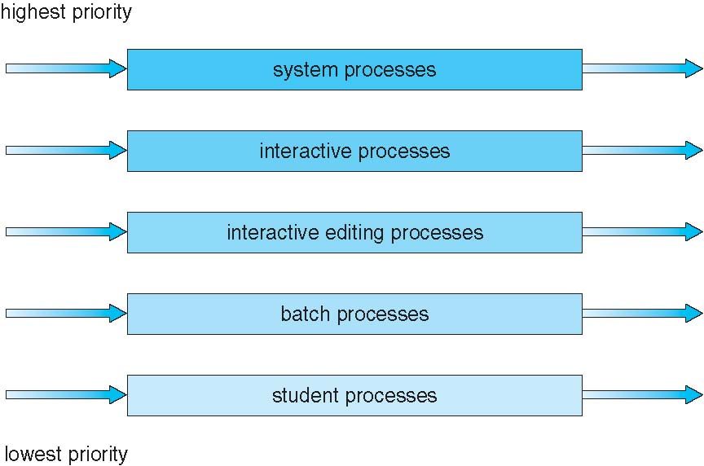
Multilevel Queue Scheduling
Notes:
3
No process in the batch queue, for example, could run unless the queues for system processes, interactive processes, and interactive editing processes were all empty.

Slide 4
Multilevel Feedback Queue
A process can move between the various queues; aging can be implemented this way
Multilevel-feedback-queue scheduler defined by the following parameters:
  number of queues
  scheduling algorithms for each queue
  method used to determine when to upgrade a process
  method used to determine when to demote a process
  method used to determine which queue a process will enter when that process needs service
Notes:
4

Slide 5
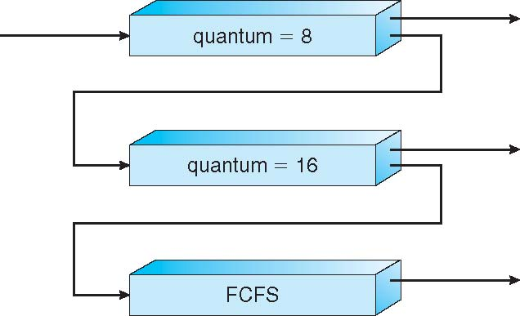
Example of Multilevel Feedback Queue
Three queues:
  Q0 – RR with time quantum 8 milliseconds
  Q1 – RR time quantum 16 milliseconds
  Q2 – FCFS
Scheduling
  A new job enters queue Q0 which is served FCFS
    When it gains CPU, job receives 8 milliseconds
    If it does not finish in 8 milliseconds, job is moved to queue Q1
  At Q1 job is again served FCFS and receives 16 additional milliseconds
    If it still does not complete, it is preempted and moved to queue Q2
Notes:
5
The scheduler first executes all processes in queue 0. Only when queue 0 is empty will it execute processes in queue 1.
This scheduling algorithm gives highest priority to any process with a CPU burst of 8 milliseconds or less. Such a process will quickly get the CPU, finish its CPU burst, and go off to its next I/0 burst. Processes that need more than 8 but less than 24 milliseconds are also served quickly, although with lower priority than shorter processes. Long processes automatically sink to queue 2 and are served in FCFS order with any CPU cycles left over from queues 0 and 1.

Slide 6
Question
Many CPU-scheduling algorithms are parameterized. For example, the RR algorithm requires a parameter to indicate the time slice. Multilevel feedback queues require parameters to define the number of queues, the scheduling algorithms for each queue, the criteria used to move processes between queues, and so on. These algorithms are thus really sets of algorithms (for example, the set of RR algorithms for all time slices, and so on). One set of algorithms may include another (for example, the FCFS algorithm is the RR algorithm with an infinite time quantum).What (if any) relation holds between the following pairs of algorithm sets?
  Priority and SJF
  Multilevel feedback queues and FCFS
  Priority and FCFS
  RR and SJF

Slide 7
Answer
The shortest job has the highest priority.
The lowest level of MLFQ is FCFS.
FCFS gives the highest priority to the job having been in existence the longest.
None.

Slide 8
Multiple-Processor Scheduling
CPU scheduling is way more complex when multiple CPUs are available
Homogeneous processors within a multiprocessor
Asymmetric multiprocessing – only one processor accesses the system data structures, alleviating the need for data sharing
Symmetric multiprocessing (SMP) – each processor is self-scheduling, all processes in common ready queue, or each has its own private queue of ready processes
  Currently, most common
Processor affinity – process has affinity for processor on which it is currently running
  soft affinity
  hard affinity
  Variations including processor sets
Notes:
8
If we have multiple processors trying to access and update a common data structure, the scheduler must be programmed carefully. We must ensure that two processors do not choose the same process and that processes are not lost from the queue.
When an operating system has a policy of attempting to keep a process running on the same processor-but not guaranteeing that it will do so-we have a situation known as soft affinity.
Here, it is possible for a process to migrate between processors.
Some systems -such as LinuX -also provide system calls that support hard affinity, thereby allowing a process to specify that it is not to migrate to other processors.

Slide 9
Multiple-Processor Scheduling – Load Balancing
If SMP, need to keep all CPUs loaded for efficiency
Load balancing attempts to keep workload evenly distributed
Push migration – periodic task checks load on each processor, and if found pushes task from overloaded CPU to other CPUs
Pull migration – idle processors pulls waiting task from busy processor

Slide 10
Multicore Processors
Multiple processor cores on a physical chip
  …began when Moore’s Law failed
  lower power than clock speedup
  some computations go faster in parallel
Multiple threads per core also very common
  Hyperthreading, multiple ALU’s etc.
  Takes advantage of memory stall to make progress on another thread while memory retrieve is happening
Notes:
Memory stall: when a processor accesses memory, it spends a significant amount of time waiting for the data to become available. (cache miss)

