Slide 1
CPU Scheduling (6)
Dr. Clinton Jeffery
CSE325 Principles of Operating Systems
9/14/2022

Slide 2
Multicore Processors
Multiple processor cores on a physical chip
…began when Moore’s Law failed
lower power than clock speedup
some jobs can go faster in parallel
Multiple threads per core also very common
Hyperthreading, multiple ALU’s etc.
Takes advantage of memory stall to make progress on another thread while memory retrieve is happening
Notes:
Memory stall: when a processor accesses memory, it spends a significant amount of time waiting for the data to become available. (cache miss)

Slide 3
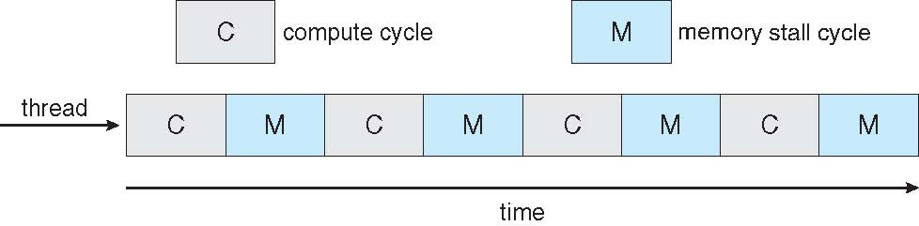

Multithreaded Multicore
Notes:
two (or more) hardware threads are assigned to each core. That way, if one thread stalls while waiting for memory, the core can switch to another thread.

Slide 4
Real-Time CPU Scheduling
Can present obvious challenges
Soft real-time systems – no guarantee as to when critical real-time process will be scheduled
Hard real-time systems – guarantees task will be serviced by its deadline
Two types of latencies affect performance
Interrupt latency – time from arrival of interrupt to start of routine that services interrupt
Dispatch latency – time for scheduler to take current process off CPU and switch to another
Notes:
4

Slide 5
Real-Time CPU Scheduling (Cont.)
Conflict phase of dispatch latency:
Preemption of any process running in kernel mode
Release by low-priority process of resources needed by high-priority processes
Notes:
In Solaris, the dispatch latency with preemption disabled is over a hundred milliseconds. With preemption enabled, it is reduced to less than a millisecond.
5

Slide 6
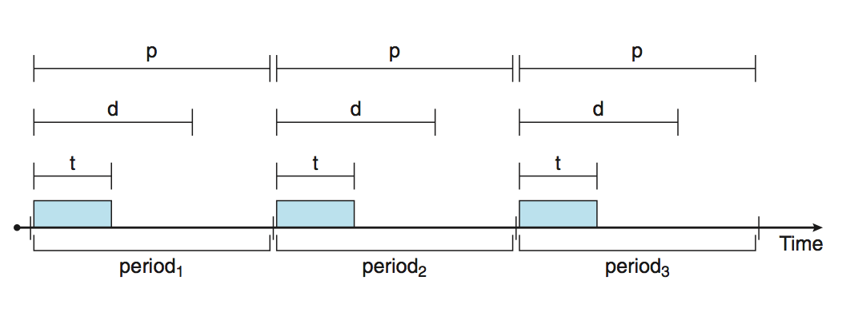
Priority-based Scheduling
For real-time scheduling, scheduler must support preemptive, priority-based scheduling
But only guarantees soft real-time
For hard real-time must also provide ability to meet deadlines
Processes have new characteristics: periodic - processes require CPU at constant intervals
Has processing time t, deadline d, period p
0 ≤ t ≤ d ≤ p
Rate of periodic task is 1/p
Notes:
Using a technique known as an admission-control algorithm, the scheduler does one of two
things. It either admits the process, guaranteeing that the process will complete on time, or rejects the request as impossible if it cannot guarantee that the task will be serviced by its deadline.
6

Slide 7
Rate Monotonic Scheduling
A priority is assigned based on the inverse of its period
Shorter periods = higher priority;
Longer periods = lower priority
Notes:
7
P2 = 35
P1 = 20

Slide 8
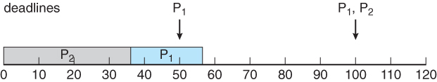
Example
Suppose that process P1 has a period of 50, an execution time of 20, and a deadline that matches its period ( 50 ).
Similarly suppose that process P2 has period 100, execution time of 35, and deadline of 100.
The total CPU utilization time is 20 / 50 = 0.4 for P1, and 35 / 100 = 0.35 for P2, or 0.75 ( 75% ) overall.
However if P2 is allowed to go first (FCFS), then P1 cannot complete before its deadline:
Notes:
FCFS, P2 arrives first
8

Slide 9
Midterm Exam 1
Friday, Sept. 30, on Canvas after class
Take-home, open book, open notes
Calculator is allowed
Review will be given in the class of Monday, Sept. 26

Slide 10
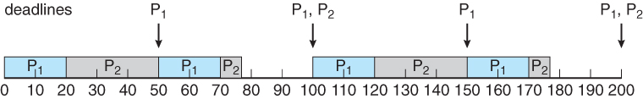
Example
if P1 is given higher priority, it gets to go first, and P2 starts after P1 completes its burst.
At time 50 when the next period for P1 starts, P2 has only completed 30 of its 35 needed time units, but it gets pre-empted by P1.
At time 70, P1 completes its task for its second period, and the P2 is allowed to complete its last 5 time units.
Overall both processes complete at time 75, and the cpu is then idle for 25 time units, before the process repeats.

Slide 11
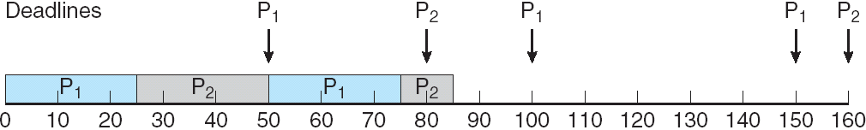
Missed Deadlines with Rate Monotonic Scheduling
P1 =50, T1 = 25, P2 = 80, T2 = 35, and the deadlines match the periods.
Notes:
11
For example, supposing that P1 =50, T1 = 25, P2 = 80, T2 = 35, and the deadlines match the periods.
Overall CPU usage is 25/50 = 0.5 for P1, 35 / 80 =0.44 for P2, or 0.94 ( 94% ) overall, indicating it should be possible to schedule the processes.
With rate-monotonic scheduling, P1 goes first, and completes its first burst at time 25.
P2 goes next, and completes 25 out of its 35 time units before it gets pre-empted by P1 at time 50.
P1 completes its second burst at 75, and then P2 completes its last 10 time units at time 85, missing its deadline of 80 by 5 time units. :-(

Slide 12
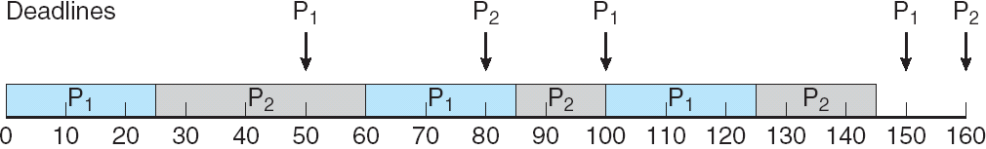
Earliest Deadline First Scheduling (EDF)
Priorities are assigned according to deadlines:
the earlier the deadline, the higher the priority;
the later the deadline, the lower the priority
Previous example:
P1 =50, T1 = 25, P2 = 80, T2 = 35, and the deadlines match the periods.
Notes:
12
At time 0 P1 has the earliest deadline, highest priority, and goes first., followed by P2 at time 25 when P1 completes its first burst.
At time 50 process P1 begins its second period, but since P2 has a deadline of 80 and the deadline for P1 is not until 100, P2 is allowed to stay on the CPU and complete its burst, which it does at time 60.
P1 then starts its second burst, which it completes at time 85. P2 started its second period at time 80, but since P1 had an earlier deadline, P2 did not pre-empt P1.
P2 starts its second burst at time 85, and continues until time 100, at which time P1 starts its third period.
At this point P1 has a deadline of 150 and P2 has a deadline of 160, so P1 preempts P2.
P1 completes its third burst at time 125, at which time P2 starts, completing its third burst at time 145.
The CPU sits idle for 5 time units, until P1 starts its next period at 150 and P2 at 160.

Slide 13
Proportional Share Scheduling
T shares are allocated among all processes in the system
An application receives N shares where N < T
This ensures each application will receive N / T of the total processor time
Must work in conjunction with an admission-control policy to guarantee that an application receives its allocated share of time.
Notes:
Assume that a total of T = 100 shares is to be divided among three processes,
A, B, and C. Ais assigned 50 shares, B is assigned 15 shares, and C is assigned
20 shares. This scheme ensures that A will have 50 percent of total processor
time, B will have 15 percent, and C will have 20 percent.
13

