Slide 1
Deadlocks (1)
Dr. Clinton Jeffery
CSE325 Principles of
Operating Systems
10/10/2022

Slide 2
Deadlock
The permanent blocking of a set of processes that either compete for system resources or communicate with each other
A set of processes is deadlocked when each process in the set is blocked awaiting an event that can only be triggered by another blocked process in the set
Permanent
No efficient solution
Notes:
Deadlock can be defined as the permanent blocking of a set of processes that either compete for system resources or communicate with each other. A set of processes is deadlocked when each process in the set is blocked awaiting an event (typically the freeing up of some requested resource) that can only be triggered by another blocked process in the set. Deadlock is permanent because none of the events is ever triggered. Unlike other problems in concurrent process management, there is no efficient solution in the general case.

Slide 3
3
c
b
2
3
2
4
d
a
4
1
1
(a) Deadlock possible
(b) Deadlock
Traffic Deadlock
Notes:
All deadlocks involve conflicting needs for resources by two or more processes. A common example is the traffic deadlock. Figure 6.1a shows a situation in which four cars have arrived at a four-way stop intersection at approximately the same time. The four quadrants of the intersection are the resources over which control is needed. In particular, if all four cars wish to go straight through the intersection, the resource requirements are as follows:
• Car 1, traveling north, needs quadrants a and b.
• Car 2 needs quadrants b and c.
• Car 3 needs quadrants c and d.
• Car 4 needs quadrants d and a.
The rule of the road in the United States is that a car at a four-way stop should defer to a car immediately to its right. This rule works if there are only two or three cars at the intersection. For example, if only the northbound and westbound cars arrive at the intersection, the northbound car will wait and the westbound car proceeds. However, if all four cars arrive at about the same time, each will refrain from entering the intersection, this causes a potential deadlock. The deadlock is only potential, not actual, because the necessary resources are available for any of the cars to proceed. If one car eventually does proceed, it can do so.
However, if all four cars ignore the rules and proceed (cautiously) into the
intersection at the same time, then each car seizes one resource (one quadrant) but
cannot proceed because the required second resource has already been seized by
another car. This is an actual deadlock.

Slide 4
Example 1: Reusable Resources
Notes:
As an example of deadlock involving reusable resources, consider two processes that compete for exclusive access to a disk file D and a tape drive T. The programs engage in the operations depicted in Figure 6.4 . Deadlock occurs if each process holds one resource and requests the other. For example, deadlock occurs if the multiprogramming system interleaves the execution of the two processes as follows:
p 0 p 1 q 0 q 1 p 2 q 2
It may appear that this is a programming error rather than a problem for the OS designer. However, we have seen that concurrent program design is challenging. Such deadlocks do occur, and the cause is often embedded in complex program logic, making detection difficult. One strategy for dealing with such a deadlock is to impose system design constraints concerning the order in which resources can be requested.

Slide 5
Example 2:
Memory Request
Space is available for allocation of 200Kbytes, and the following sequence of events occur:
Deadlock occurs if both processes progress to their second request
P1
P2
. . .
. . .
Request 80 Kbytes;
Request 70 Kbytes;
. . .
. . .
Request 60 Kbytes;
Request 80 Kbytes;
Notes:
Another example of deadlock with a reusable resource has to do with requests for main memory. Suppose the space available for allocation is 200 Kbytes, and the following sequence of requests occurs: (see diagram)
Deadlock occurs if both processes progress to their second request. If the amount of memory to be requested is not known ahead of time, it is difficult to deal with this type of deadlock by means of system design constraints. The best way to deal with this particular problem is, in effect, to eliminate the possibility by using virtual memory, which is discussed in Chapter 8 .

Slide 6
System Model
System consists of resources
Resource types R₁, R₂, . . ., R_{m}
  CPU cycles, memory space, I/O devices
Each resource type R_{i} has W_{i} instances.
Each process utilizes a resource as follows:
  request
  use
  release
Notes:
Two CPUs

Slide 7
Deadlock Characterization
Deadlock can arise if four conditions hold simultaneously.
Mutual exclusion: only one process at a time can use a resource
Hold and wait: a process holding at least one resource is waiting to acquire additional resources held by other processes
No preemption: a resource can be released only voluntarily by the process holding it, after that process has completed its task
Circular wait: there exists a set {P₀, P₁, …, P_{n}} of waiting processes such that P₀ is waiting for a resource that is held by P₁, P₁ is waiting for a resource that is held by P₂, …, P_{n–1} is waiting for a resource that is held by P_{n}, and P_{n} is waiting for a resource that is held by P₀.
Notes:
The circular-wait condition implies the hold-and-wait condition

Slide 8
Resource-Allocation Graph
A set of vertices V and a set of edges E.
V is partitioned into two types:
  P = {P₁, P₂, …, P_{n}}, the set consisting of all the processes in the system
  R = {R₁, R₂, …, R_{m}}, the set consisting of all resource types in the system
request edge – directed edge P_{i} → R_{j}
assignment edge – directed edge R_{j} → P_{i}

Slide 9
Resource-Allocation Graph (Cont.)
Process
Resource Type with 4 instances
P_{i} requests instance of R_{j}
P_{i} is holding an instance of R_{j}
P_{i}
R_{j}
P_{i}
R_{j}

Slide 10
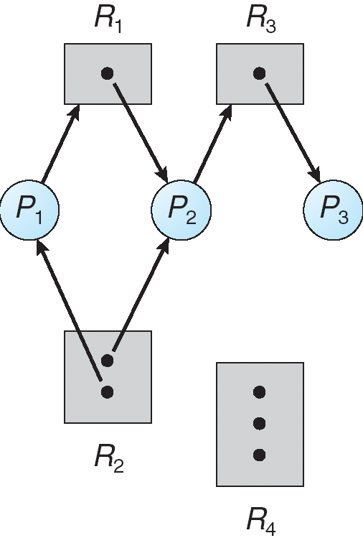
Example of a Resource Allocation Graph
Notes:
Process states:
Process P1 is holding an instance of resource type R2 and is waiting for an instance of resource type R1 .
Process P2 is holding an instance of R1 and an instance of R2 and is waiting for an instance of R3.
Process P3 is holding an instance of R3 .

Slide 11
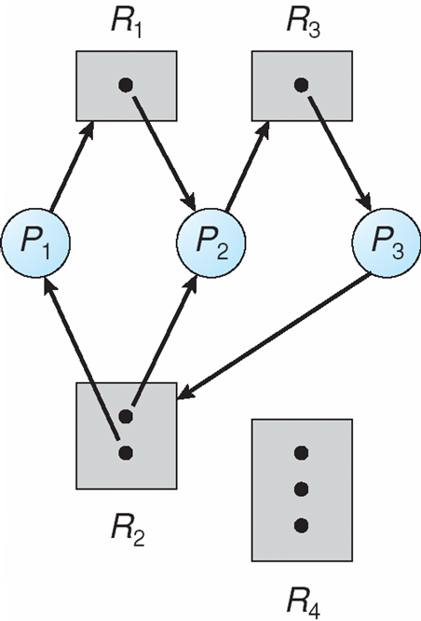
Resource Allocation Graph With A Deadlock
Notes:
If the graph contains no cycles, then no process in the system is deadlocked. If the graph does contain a cycle, then a deadlock may exist.

Slide 12
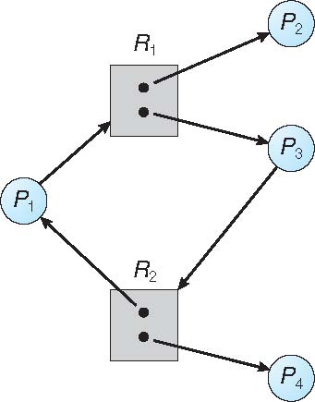
Graph With A Cycle But No Deadlock
Notes:
process P4 may release its instance of resource type R2. That resource can then be allocated to P3, breaking the cycle. (P2)

Slide 13
Basic Facts
If graph contains no cycles ⇒ no deadlock
If graph contains a cycle ⇒
  if only one instance per resource type, then deadlock
  if several instances per resource type, possibility of deadlock

Slide 14
Methods for Handling Deadlocks
Ensure that the system will never enter a deadlock state:
  Deadlock prevention
  Deadlock avoidance
Allow the system to enter a deadlock state and then detect and recover
Ignore the problem and pretend that deadlocks never occur in the system; used by most operating systems, including UNIX
Notes:
It is then up to the application developer to write programs that handle deadlocks.

Slide 15
Deadlock Prevention
Restrain the ways request can be made
Mutual Exclusion – not required for sharable resources (e.g., read-only files); must hold for non-sharable resources
Hold and Wait – must guarantee that whenever a process requests a resource, it does not hold any other resources
  Require process to request and be allocated all its resources before it begins execution, or allow process to request resources only when the process has none allocated to it.
  Low resource utilization; starvation possible
Notes:
Deadlock prevention provides a set of methods for ensuring that at least one of the necessary conditions cannot hold.

Slide 16
Deadlock Prevention (Cont.)
No Preemption –
  If a process that is holding some resources requests another resource that cannot be immediately allocated to it, then all resources currently being held are released
  Preempted resources are added to the list of resources for which the process is waiting
  Process will be restarted only when it can regain its old resources, as well as the new ones that it is requesting
Circular Wait – impose a total ordering of all resource types, and require that each process requests resources in an increasing order of enumeration

Slide 17
Deadlock Avoidance
Requires that the system has some additional a priori information available
Simplest and most useful model requires that each process declare the maximum number of resources of each type that it may need
The deadlock-avoidance algorithm dynamically examines the resource-allocation state to ensure that there can never be a circular-wait condition
Resource-allocation state is defined by the number of available and allocated resources, and the maximum demands of the processes

Slide 18
Safe State
When a process requests an available resource, system must decide if immediate allocation leaves the system in a safe state
System is in safe state if there exists a sequence <P₁, P₂, …, P_{n}> of ALL the processes in the systems such that for each P_{i}, the resources that P_{i} can still request can be satisfied by currently available resources + resources held by all the P_{j}, with j < i
That is:
  If P_{i} resource needs are not immediately available, then P_{i} can wait until all P_{j} have finished
  When P_{j} is finished, P_{i} can obtain needed resources, execute, return allocated resources, and terminate
  When P_{i} terminates, P_{i +1} can obtain its needed resources, and so on

