Slide 1
Memory Management (2)
Dr. Clinton Jeffery
CSE325 Principles of
Operating Systems
10/21/2022

Slide 2
Dynamic Memory
Allocation Problem
How to satisfy a request of size n from a list of free holes?
First-fit: Allocate the first hole that is big enough
Best-fit: Allocate the smallest hole that is big enough; must search entire list, unless ordered by size
  Produces the smallest leftover hole
Worst-fit: Allocate the largest hole; must also search entire list
  Produces the largest leftover hole
First-fit and best-fit better than worst-fit in terms of speed and storage utilization
Notes:
First-fit is faster.
Best-fit is better in terms of storage utilization.
Worst-fit may lead less fragmentation.

Slide 3




Allocation Example
Memory
Best-fit
Worst-fit
First-fit

Slide 4
In-class Work 5
Give five memory partitions of 100KB, 500KB, 200KB, 300KB and 600KB (in order), how would each of the first-fit, best-fit, and worst-fit algorithms place processes of 212KB, 417KB, 112KB, and 426KB (in order)? Which algorithm makes the most efficient use of memory?
Notes:
First fit: 500KB (288KB left), 600KB (183KB left), 500KB (176KB left), stuck
Best fit: 300KB (78 left), 500KB (83left), 200KB (88left), 600KB(174left)
Worst-fit: 600KB (388left), 500KB (83left), 600KB(276left), stuck

Slide 5
Fragmentation
External Fragmentation – total memory space exists to satisfy a request, but it is not contiguous
Internal Fragmentation – allocated memory may be slightly larger than requested memory; this size difference is memory internal to a partition, but not being used
Notes:
Have 18,464 bytes. Suppose that the next process requests 18,462 bytes. If we allocate exactly the requested block, we are left with a hole of 2 bytes. The overhead to keep track of this hole will be substantially larger than the hole itself.

Slide 6
Fragmentation (Cont.)
Reduce external fragmentation by compaction
  Shuffle memory contents to place all free memory together in one large block
  Compaction is possible only if relocation is dynamic, and is done at execution time
Another solution is to allow the logical address space of the processes to be noncontiguous.

Slide 7
x86 Address Translation
CPU generates virtual address (seg, offset)
  Given to segmentation unit
    Which produces linear addresses
  Linear address given to paging unit
    Which generates physical address in main memory

Slide 8
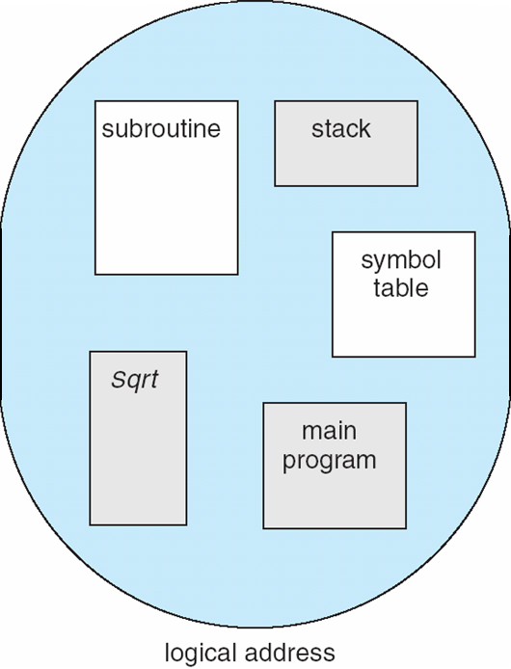
Segmentation
Divide virtual address space into separate logical segments; each is part of physical memory.
A natural extension of variable-sized partition
  variable-sized partition = 1 segment/process
  segmentation = many segments/process

Slide 9
Logical View of Segmentation
1
1
4
2
3
4
2
3
user space
physical memory space

Slide 10
Segmentation Translation
Virtual address: <segment-number, offset>
Segment table maps segment number to segment information
  Base: starting address of the segment in physical memory
  Limit: length of the segment
  Addition metadata includes protection bits (validation bit, r/w/e priviledges etc.)
Limit & protection checked on each access

Slide 11
x86 Segment Selector
Logical address: segment selector + offset
Segment selector stored in segment registers (16-bit)
  cs: code segment selector
  ss: stack segment selector
  ds: data segment selector
  es,fs,gs: extra
Segment register can be implicitly or explicitly specified
  Implicit by type of memory reference (jmp)
    mov $8049780, %eax // implicitly use ds
  Through special registers (cs,ss,ds,es,fs,gs on x86)
    mov %ss:$8049780, %eax // explicitly use ss
Support for segmentation removed in x86-64
  cs, ss, ds, and es are forced to 0
Notes:
The x86-64 architecture does not use segmentation in long mode (64-bit mode). Four of the segment registers: CS, SS, DS, and ES are forced to 0
In the Intel 80386 and later, protected mode retains the segmentation mechanism of 80286 protected mode, but a paging unit has been added as a second layer of address translation between the segmentation unit and the physical bus.

Slide 12
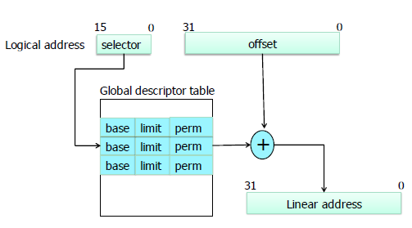
x86 Segmentation Hardware

Slide 13
xv6 Segments
vm.c, ksegment()
Rely mainly on paging (like Linux)
Kernel code: readable + executable in kernel mode
Kernel data: writeable in kernel mode
User code: readable + executable in user mode
User data: writable in user mode
These are all null mappings
  Map to [0, 0xFFFFFFFF]
  linear address = offset
Notes:
this is a very limited/boring use of segments!

