Slide 1
Memory Management (3)
Dr. Clinton Jeffery
CSE325 Principles of Operating Systems
10/24/2022

Slide 2
Pros and Cons of Segmentation
Advantages
Some segments can be shared
Easier to relocate segment than entire program
Avoid allocating unused memory
Flexible protection
Efficient translation
Segment table small -> easy to fit in MMU
Disadvantages
Segment variable lengths -> constant pain to fit
External fragmentation: memory waste

Slide 3
Paging
Allow physical address space of a process to be noncontiguous
Process is allocated fixed sized units of physical memory when available
Much smaller units than entire regions/segments
Avoids external fragmentation
Avoids problem of varying sized memory chunks
Still have Internal fragmentation
Dictated or constrained by Hardware!

Slide 4
Paging
Divide physical memory into fixed-sized blocks called frames
Size is power of 2, 512 bytes to 16 MB, 4k typical
HW may require certain sizes, otherwise OS picks
Divide logical memory into blocks of same size called pages
OS keeps track of all free frames
To run a program of size N pages, need to find N free frames and load program
Set up a page table to translate logical to physical addresses

Slide 5
Address Translation Scheme
Address generated by CPU is divided into:
Page number (p) – used as an index into a page table which contains base address of each page in physical memory
Page offset (d) – combined with base address to define the physical memory address that is sent to the memory unit
For given logical address space 2^{m} and page size 2^{n}

Slide 6
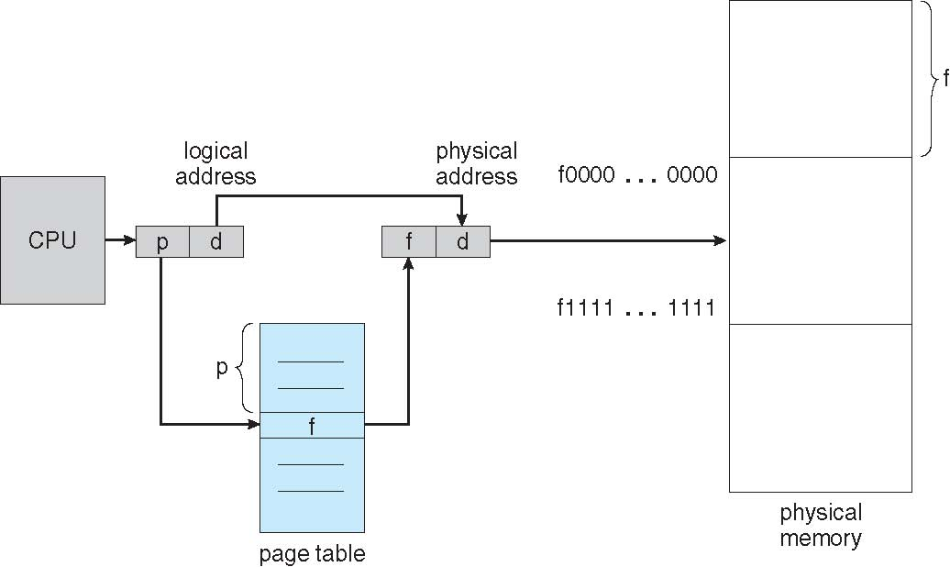
Page Translation

Slide 7
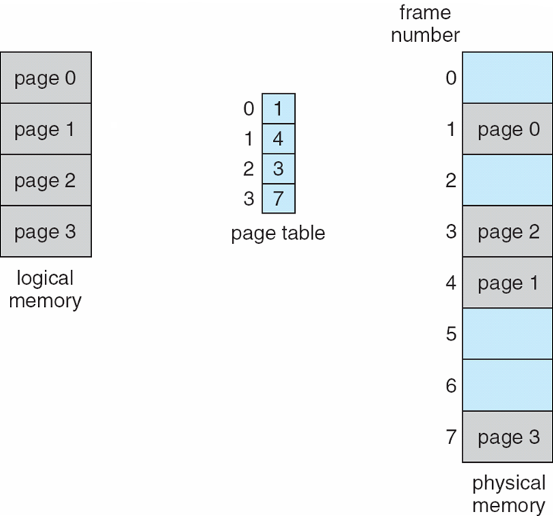
Page Translation Example

Slide 8
Page Translation Exercise
8-bit virtual address, 10-bit physical address, and each page is 64 bytes
How many virtual pages?
How many physical pages?
How many entries in page table?
Given page table = [2, 5, 1, 8], what’s the physical address for virtual address 241?
m-bit virtual address, n-bit physical address, k-bit page size
What are the answers to the first three questions above?
Notes:
64 = 2^6 -> 6 bits for page offset
2 bits for VPN -> 4 virtual pages
4 bits for PPN -> 16 physical pages
4 entries in page table
241 = 0xF1 = 0x11110001
0x 0111 110001

