Slide 1
Memory Management (4)
Dr. Clinton Jeffery
CSE325 Principles of Operating Systems
10/26/2022

Slide 2
Internal Fragmentation
Calculating internal fragmentation
  Page size = 2,048 bytes
  Process size = 72,766 bytes
  35 pages + 1,086 bytes
  Internal fragmentation of 2,048 - 1,086 = 962 bytes
  Worst case fragmentation = 1 frame – 1 byte
  On average fragmentation = 1 / 2 frame size
So, small frame sizes desirable?
  But each page table entry takes memory to track
  Are page sizes growing over time?
    Old CPUs used 512 bytes, almost all now use 4KB, some 8KB
    Large page sizes (e.g. 4MB) supported on some CPUs/OSes but costs outweigh benefits under most workloads
Notes:
Process view and physical memory now very different
By implementation process can only access its own memory

Slide 3
Page Protection
Associate protection bits with each virtual page in page table
Protection bits
  present bit: map to a valid physical page?
  read/write/execute bits: can read/write/execute?
  user bit: can access in user mode?
  x86: PTE_P, PTE_W, PTE_U
Checked by MMU on each memory access

Slide 4
Page Protection Example

Slide 5
Page Allocation
Free frame management
  E.g., can put page on a free list
Allocation policy
  E.g., one page at a time, from head of free list
xv6: kalloc.c

Slide 6
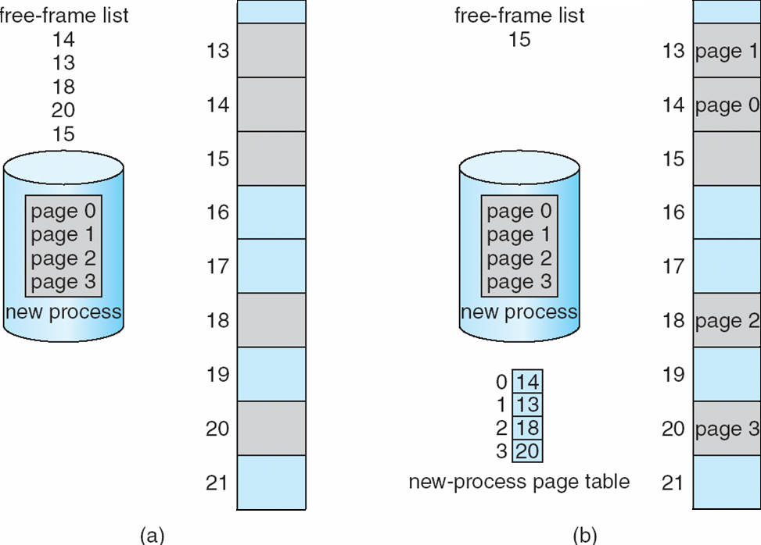
Page Allocation
Before allocation
After allocation

Slide 7
Implementation of Page Table
Page table is kept in main memory ?!
  Page-table base register (PTBR) points to the page table
    x86: cr3
  Page-table length register (PTLR) indicates size of the page table
  OS stores base in process control block (PCB)
  OS switches PTBR on each context switch
In this scheme every data/instruction access requires two memory accesses!
  One for the page table and one for the data / instruction
The two memory access problem can be solved by the use of a special fast-lookup hardware cache called associative memory or translation look-aside buffers (TLBs)

Slide 8
Structure of the Page Table
Memory structures for paging can get huge using straight-forward methods
  Consider a 32-bit logical address space as on modern computers
  Suppose you use page size of 4 KB (2¹²) (Linux, MSWin)
  Page table would have 1 million entries (2³² / 2¹²)
  If each entry is 4 bytes -> 4 MB of physical address space / memory for page table alone
    That amount of memory used to cost a lot
    Don’t want to allocate that contiguously in main memory
Hierarchical Paging
Hashed Page Tables
Inverted Page Tables

Slide 9
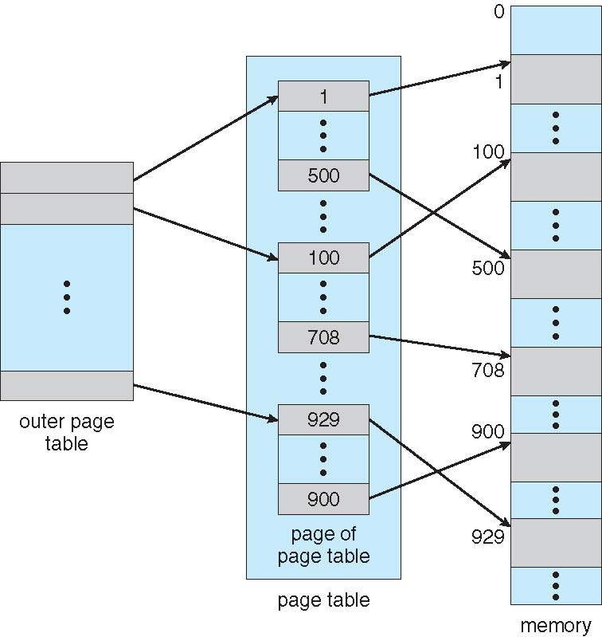
Hierarchical Page Tables
Break up the logical address space into multiple page tables
A simple technique is a two-level page table
We then page the page table

Slide 10
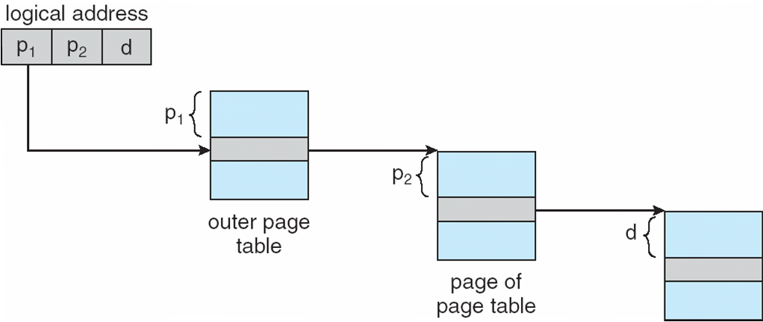
Address Translation with Hierarchical Page Table

Slide 11
x86 Page Translation
32-bit address space, 4 KB page
  4KB page -> 12 bits for page offset
How many bits for 2nd-level page table?
  Desirable to fit a 2nd-level page table in one page
  4KB/4B = 1024 -> 10 bits for 2nd-level page table
Address bits for top-level page table: 32 – 12 – 10 = 10
Notes:
4B = 32 bits for a physical address

Slide 12
x86 Paging Architecture
Notes:
Page size 4KB, hugh page size: 4MB

Slide 13
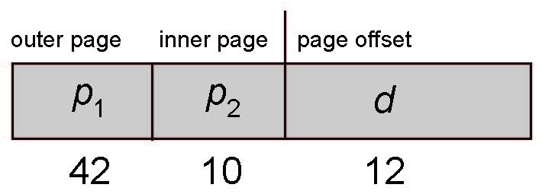
64-bit Logical Address Space
Even two-level paging scheme not sufficient
If page size is 4 KB (2¹²)
  Then page table has 2⁵² entries
  If two level scheme, inner page tables could be 2¹⁰ 4-byte entries
  Address would look like
  Outer page table has 2⁴² entries or 2⁴⁴ bytes
  One solution is to add a 2nd outer page table
  But in the following example the 2nd outer page table is still 2³⁴ bytes in size
    And possibly 4 memory access to get to one physical memory location

