Slide 1
Memory Management (5)
Dr. Clinton Jeffery
CSE325 Principles of Operating Systems
10/28/2022

Slide 2
Hashed Page Tables
Common in address spaces > 32 bits
The logical page number is hashed into a page table
This page table contains a chain of elements hashing to the same location
Each element contains (1) the logical page number (2) the value of the mapped page frame (3) a pointer to the next element
Logical page numbers are compared in this chain searching for a match
If a match is found, the corresponding physical frame is extracted
Variation for 64-bit addresses is clustered page tables
Similar to hashed but each entry refers to several pages (such as 16) rather than 1
Especially useful for sparse address spaces (where memory references are non-contiguous and scattered)

Slide 3
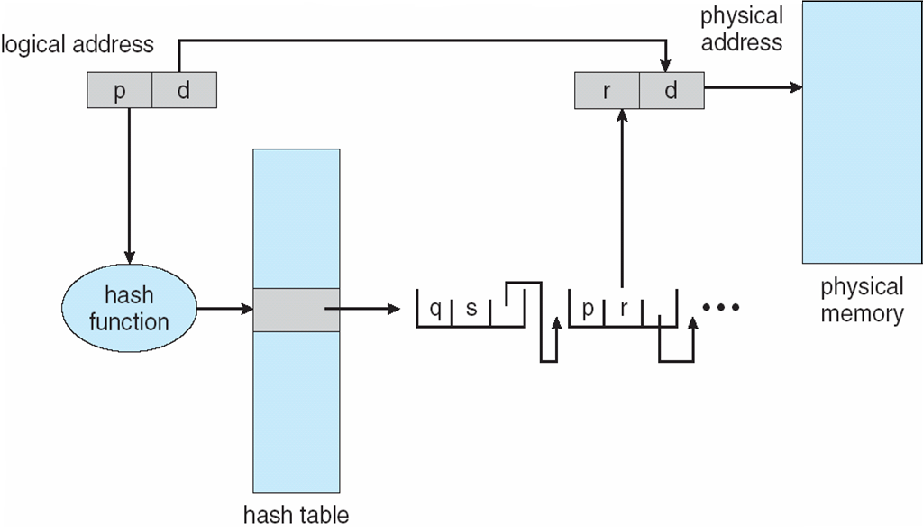
Hashed Page Table

Slide 4
Inverted Page Table
Rather than each process having a page table and keeping track of all possible logical pages, track all physical pages
One entry for each real page of memory
Entry consists of the virtual address of the page stored in that real memory location, with information about the process that owns that page
Decreases memory needed to store each page table, but increases time needed to search the table when a page reference occurs
Use hash table to limit the search to one — or at most a few — page-table entries
TLB can accelerate access
But how to implement shared memory?
One mapping of a logical address to the shared physical address
Notes:
Examples of systems using inverted page tables include the 64-bit UltraSPARC and PowerPC.
Systems that use inverted page tables have difficulty implementing shared memory. Shared memory is usually implemented as multiple virtual addresses
(one for each process sharing the memory) that are mapped to one physical address. This standard method cannot be used with inverted page tables;
because there is only one virtual page entry for every physical page, one physical page cannot have two (or more) shared virtual addresses.

Slide 5
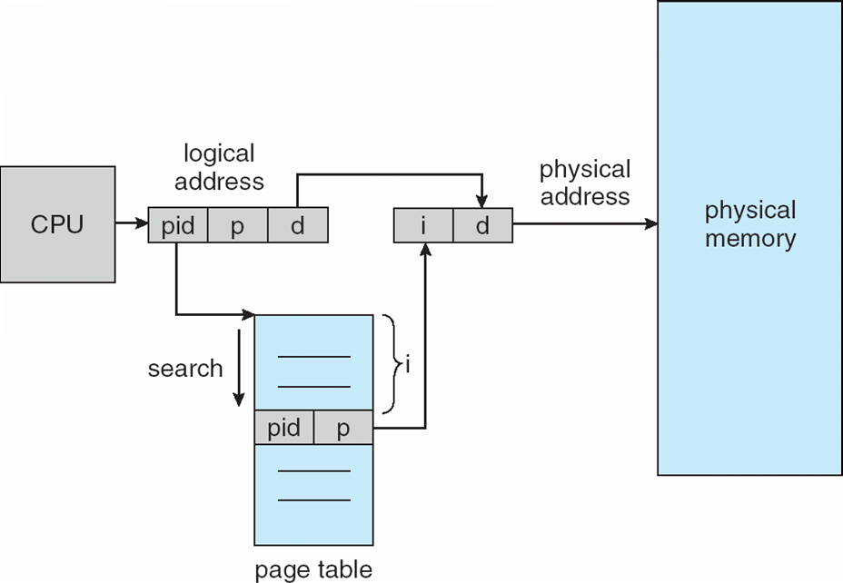
Inverted Page Table Architecture
Notes:
simplified version of the inverted page table used in the IBM RT.
The inverted page table is sorted by physical address, but lookups occur on virtual addresses, the whole table might need to be searched for a match.

Slide 6
(Historic) Example
The VAX architecture supports a variation of two-level paging. The VAX is a 32-bit machine with a page size of 512 bytes. The logical address space of a process is divided into four equal sections, each of which consists of 2³⁰ bytes. Each section represents a different part of the logical address space of a process. The first 2 high-order bits of the logical address designate the appropriate section. The next 21 bits represent the logical page number of that section, and the final 9 bits represent an offset in the desired page.
How many memory operations are performed when a user program executes a memory-load operation?
Notes:
When a memory load operation is performed, there are three memory operations that might be performed:
One is access the outer page table .
The second access is to access the page table entry itself (inner page table)
The third access is the actual memory load operation.

Slide 7
Example
Consider a computer system with a 32-bit logical address and 4-KB (2¹²B) page size. The system supports up to 512MB (2²⁹B) of physical memory. How many entries are there in each of the following?
(1) A conventional single-level page table
(2) An inverted page table

Slide 8
Answer
(1) # of pages= # of entries =????
Size of logical address space = 2^{m} = # of pages × page size
»» 2³² = # of pages × 2¹²
# of pages =2³² / 2¹²= 2²⁰ pages
(2)
Size of physical address space = # of frames × frame size
(frame size = page size )
For inverted page table, # of frames = # of entries
2²⁹= # of frames × 2¹²
# of frames =2²⁹ / 2¹²= 2¹⁷
# of entries = 2¹⁷

Slide 9
TLB
Some TLBs store address-space identifiers (ASIDs) in each TLB entry – uniquely identifies each process to provide address-space protection for that process
Otherwise need to flush at every context switch
TLBs typically small (64 to 1,024 entries)
On a TLB miss, value is loaded into the TLB for faster access next time
Replacement policies must be considered
Some entries can be wired down for permanent fast access

Slide 10
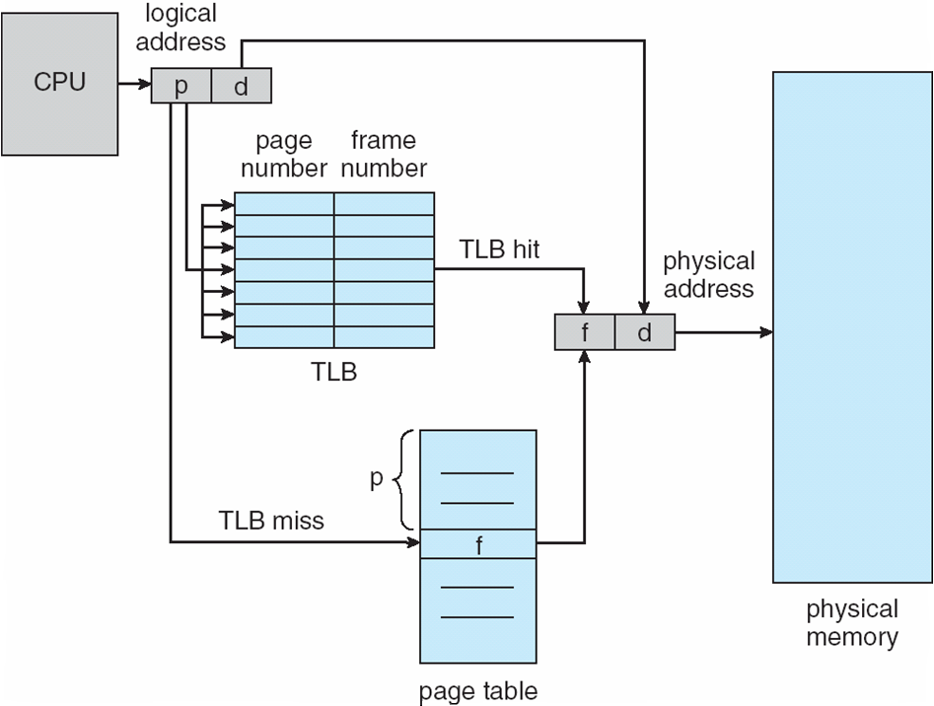
Paging Hardware With TLB

Slide 11
Effective Access Time
Associative Lookup = ε time unit
Can be < 10% of memory access time
Hit ratio = α
Hit ratio – percentage of times that a page number is found in the associative registers; ratio related to number of associative registers
Consider α = 80%, ε = 20ns for TLB search, 100ns for memory access
Effective Access Time (EAT)
EAT = (100 + ε) α + (200 + ε)(1 – α) = 200+ ε – 100α
Consider α = 80%, ε = 20ns for TLB search, 100ns for memory access
EAT = 0.80 x 120 + 0.20 x 220 = 140ns
Consider more realistic hit ratio -> α = 99%, ε = 20ns for TLB search, 100ns for memory access
EAT = 0.99 x 120 + 0.01 x 220 = 122ns

