Slide 1
CS Education
Research @ NMT
Clinton Jeffery
10/24/2022

Slide 2
Why CS Ed Research?
Greed
  Relatively easier funding
Need
  NMT CSE has real barriers to overcome
Notes:
<number>
a multithreaded Web browser could allow user interaction in one thread while an image was being loaded in another thread.
threads share the memory and the resources of the process to which they belong by default.
4. A single-threaded process can only run on one processor, regardless how many are available. Multithreading on a multi-core machine increases parallelism.

Slide 3
Why NOT CS Ed Research?
Disrespect
  It’s not computer science, it’s social science
Distraction
  I only have time left to do k more things, and I want those to be things I really care about
Notes:
<number>
a multithreaded Web browser could allow user interaction in one thread while an image was being loaded in another thread.
threads share the memory and the resources of the process to which they belong by default.
4. A single-threaded process can only run on one processor, regardless how many are available. Multithreading on a multi-core machine increases parallelism.

Slide 4
Different CS Ed Foci
Traditional CS Ed: pedagogy, etc.
  the theory side, or the “ed” side
CS Ed Tech
  If I squint at it from the right angle, can use CS Ed Tech to advance state of the art in compilers, software engineering, etc.
Woke CS Ed
  ~33-50% of current SIGCSE papers?

Slide 5
What Need for
CS Ed Tech?
Increase accessibility to key courses
  Math-for-CS
Improve success rates in key courses
  Code-level Up
Applicable at both entry-level and entry-to-grad level

Slide 6
Modeling User Knowledge to Improve Access, Success, and Retention in Computer Science
Is it possible to create an online “game” or “test” that we would accept as satisfying the prerequisite to take CSE 107 and/or CSE 113?
Is it possible to create an online “game” or “test” that can demonstrably improve success rates in CSE 107 and/or CSE 113?

Slide 7
What subset of Math 1220 is actually required in CSE 107?
Most of what we need is a little different than traditional algebra...but we need a lot

Slide 8
What subset of Math 1230/1240 is actually required in CSE 113?
Most of what we need is a little different than traditional trig/precalc… but we need a lot

Slide 9
What kind of curriculum or software environment would fix failure rates in CSE 113?
“Everyone has these failure rates”
We “fix” via excessive math prereq
  Failure rates still 40%
Others “fix” by watering down material; not a great alternative
No one has proved that a real fix is not out there

Slide 10
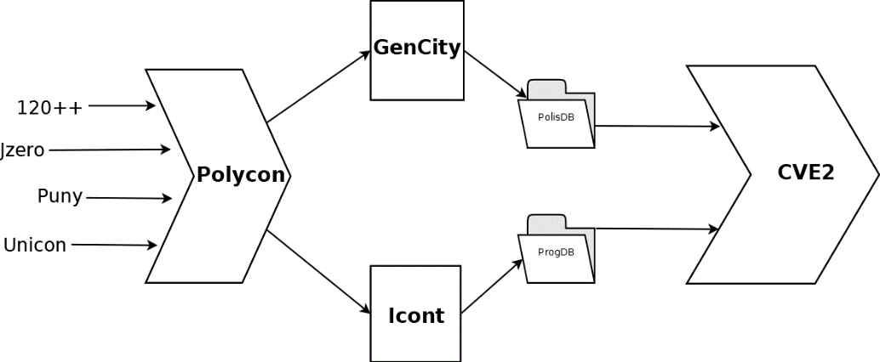
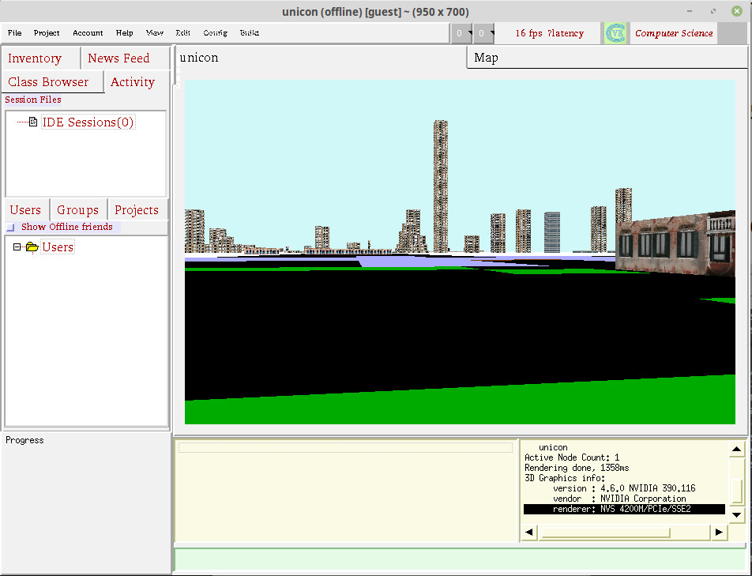
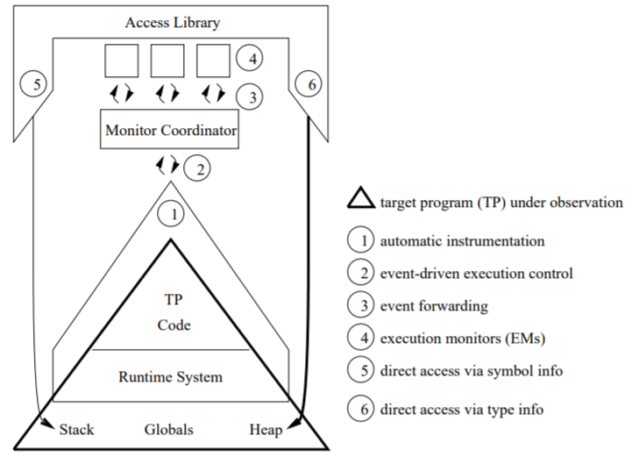
Puny
A 3D first-person-Python (subset)
+
=

